Slide 1
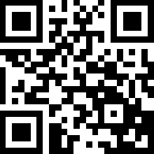
http://www.Tree-Talk.com
info@Tree-Talk.com
representative: Igor Yanovskiy
TreeTalk
Instant Voice Telecommunications
Supported by:
Notes:
TreeTalk is a startup, in which hardware, software and telecommunications become fused.

Slide 2
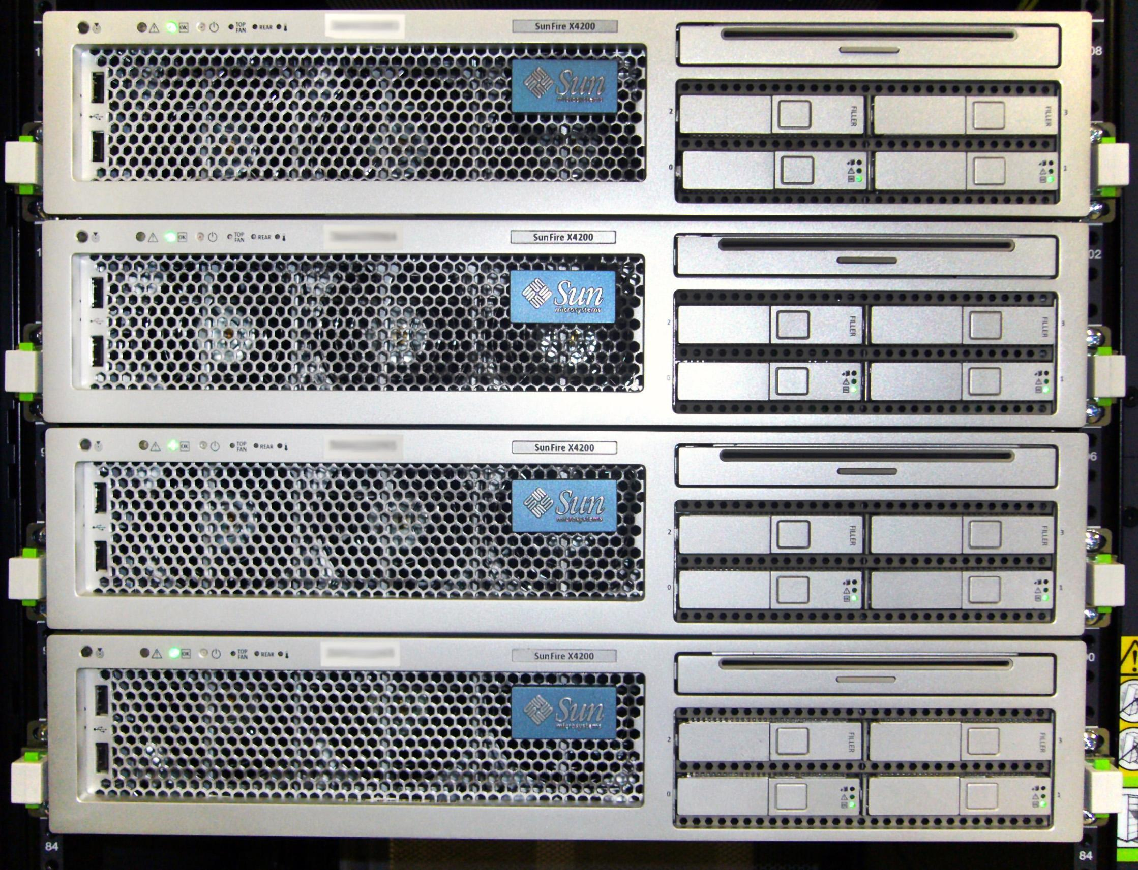
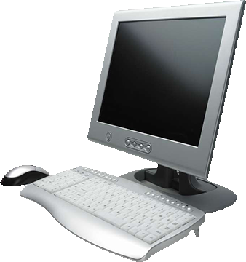
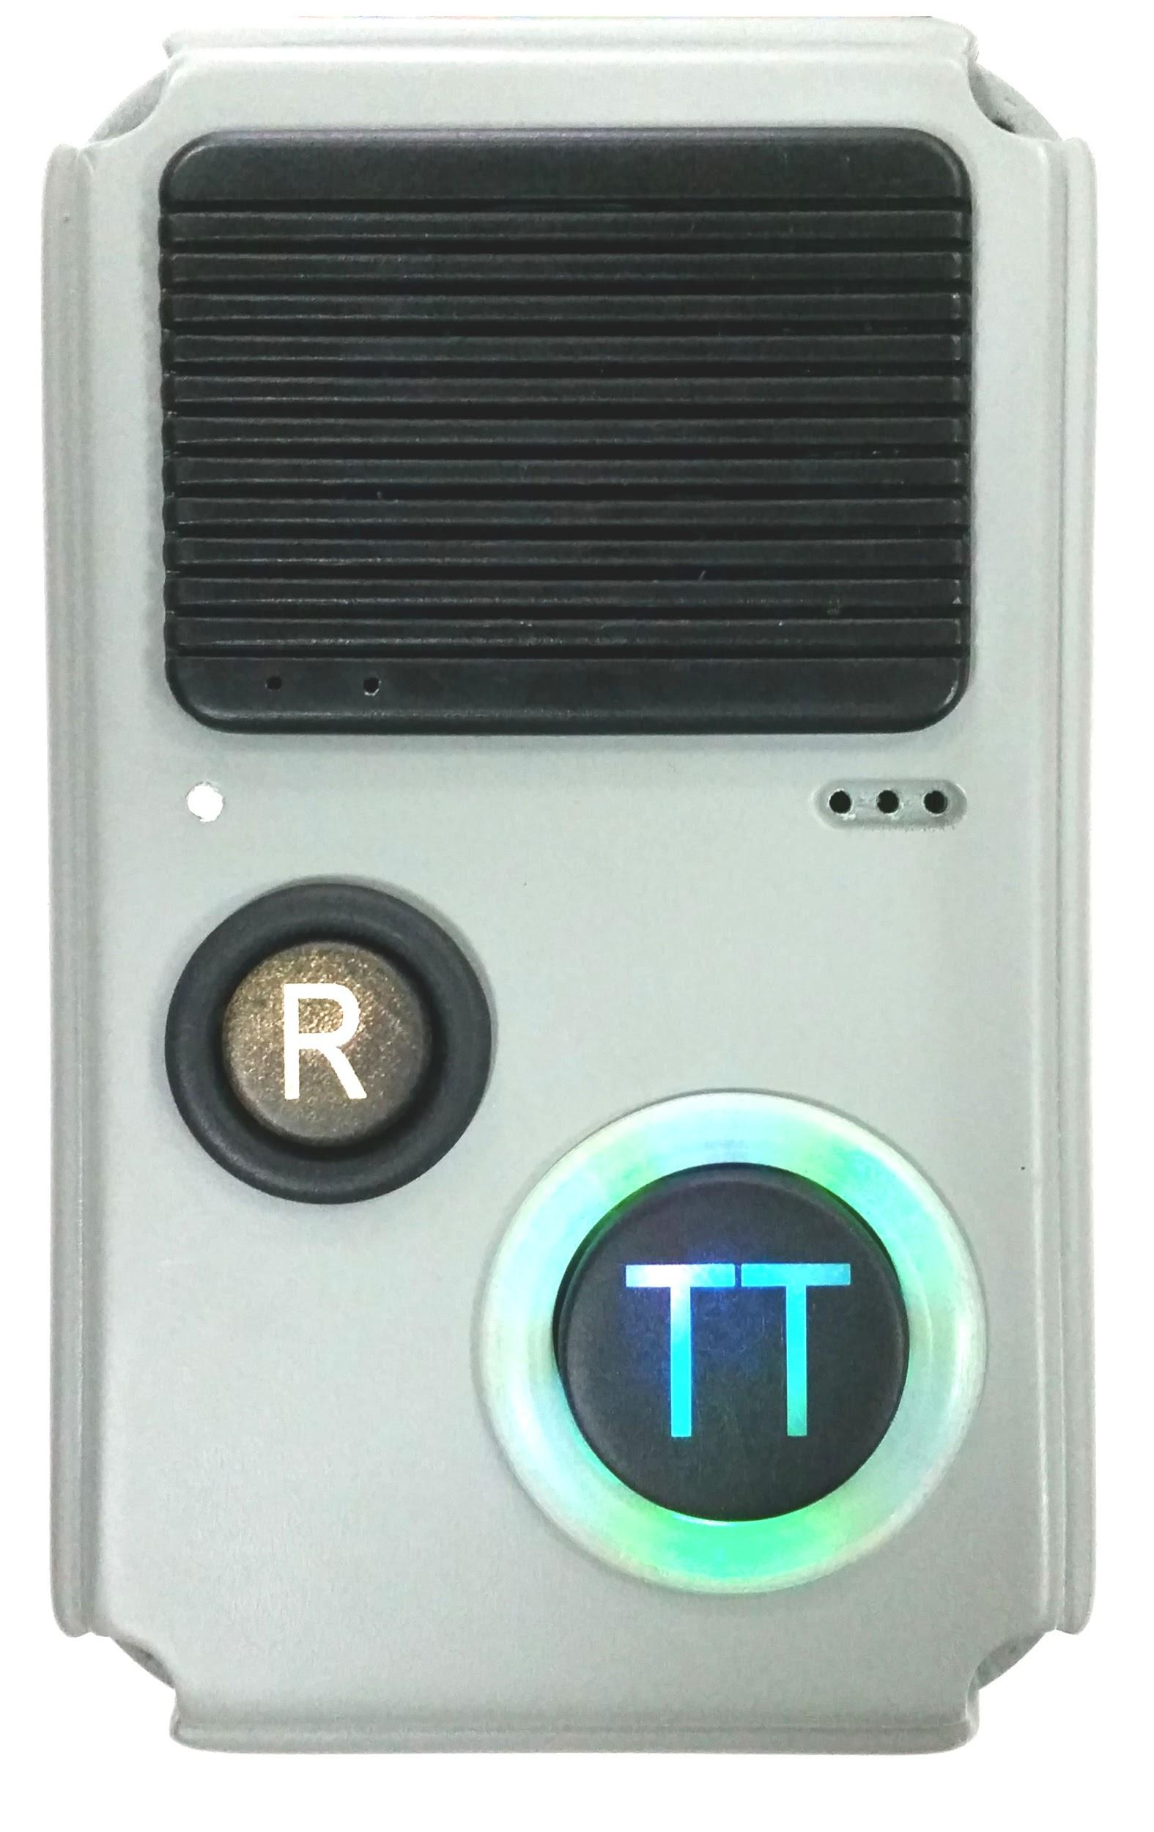
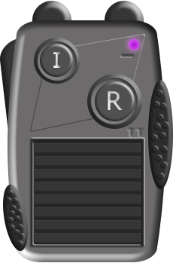
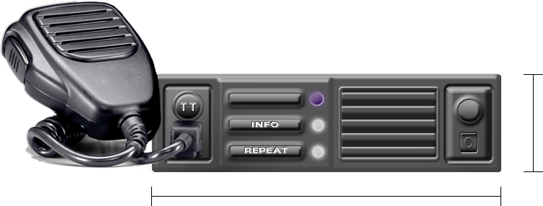
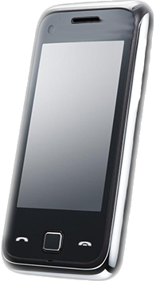
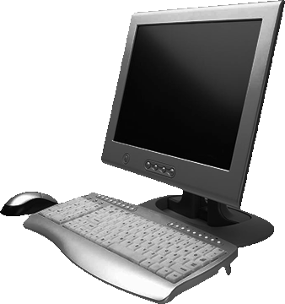
TreeTalk Telecommunications Ecosystem
Wireless
data
networks
TreeTalk Cloud
Address
server
Devices
Operator
software
Central
server
WEB
UI
Routing
servers
Mobile
app
Control
app
Intellectual Property registered: United States Patent N 9,338,275 RF UM Patent N 121411 PCT/RU2013/000062, WIPO WO 2013/162414 A1, US 2015/0072724 A1 + numerous know-hows...
www.Tree-Talk.com
www.tree-talk.com | twitter.com/TreeTalkCom | info@tree-talk.com
Notes:
We are creating a new class of mobile devices and a new global communications ecosystem.
The core of the system is the TreeTalk cloud infrastructure, working like the router for the voice channels and streams.

Slide 3
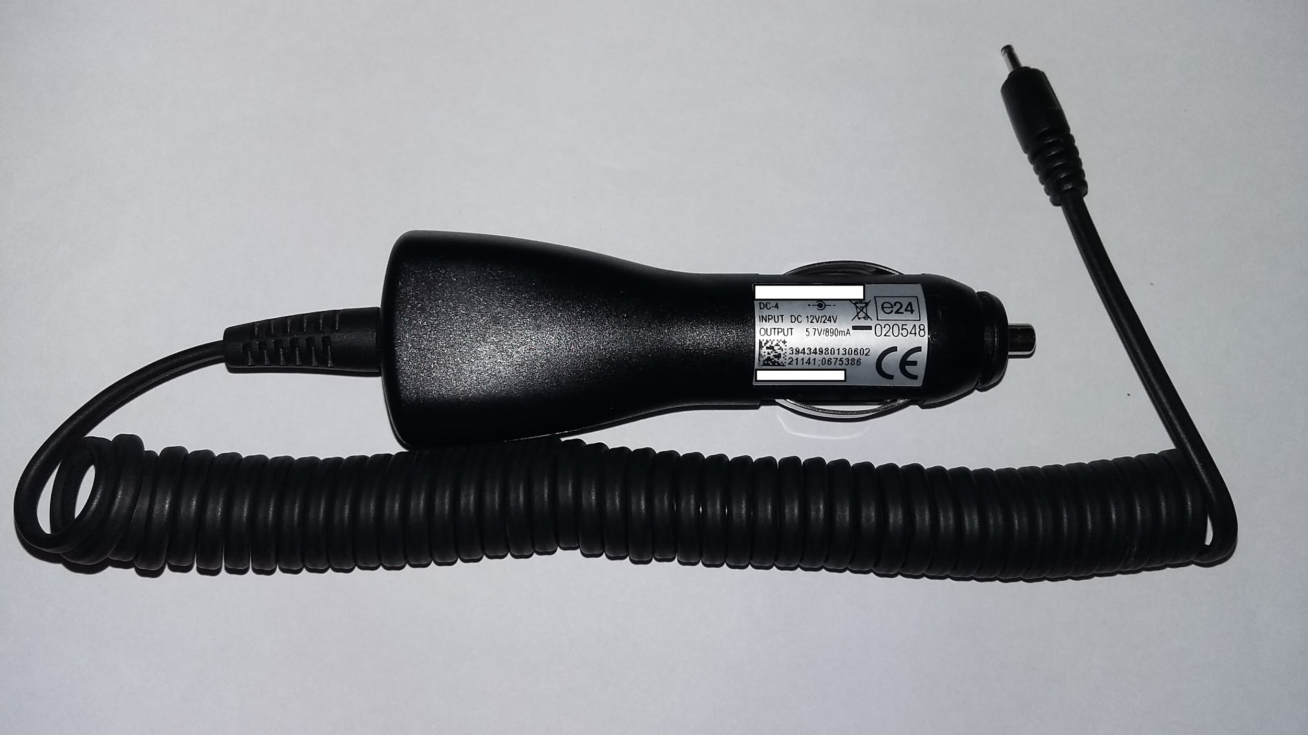
TreeTalk Ecosystem. Terminal.
50* mm
Repeat button
178* mm
* ISO 7736 / DIN 75490 compliance
PS unit
12V/24V
** Intellectual Property registered: United States Patent N 9,338,275 RF UM Patent N 121411 PCT/RU2013/000062, WIPO WO 2013/162414 A1, US 2015/0072724 A1 + numerous know-hows...
www.Tree-Talk.com
www.tree-talk.com | twitter.com/TreeTalkCom | info@tree-talk.com
Notes:
Also the system may include a variety of devices:
The Terminals the design of which is developed and patented based on customer feedback.

Slide 4
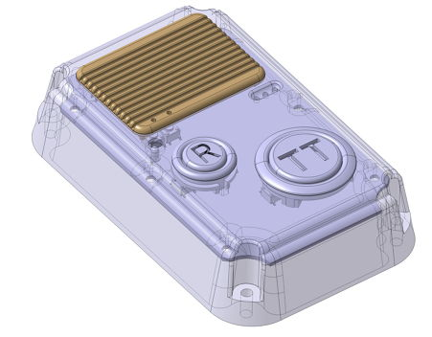
TreeTalk Ecosystem. Intercom.
Talk button
Repeat button
www.Tree-Talk.com
www.tree-talk.com | twitter.com/TreeTalkCom | info@tree-talk.com
Notes:
The multiple purpose digital intercoms

Slide 5
TreeTalk Ecosystem. Handheld.
Safe to hold
Push-to-talk
www.Tree-Talk.com
www.tree-talk.com | twitter.com/TreeTalkCom | info@tree-talk.com
Notes:
The handheld communication similar to walkie-talkie

Slide 6
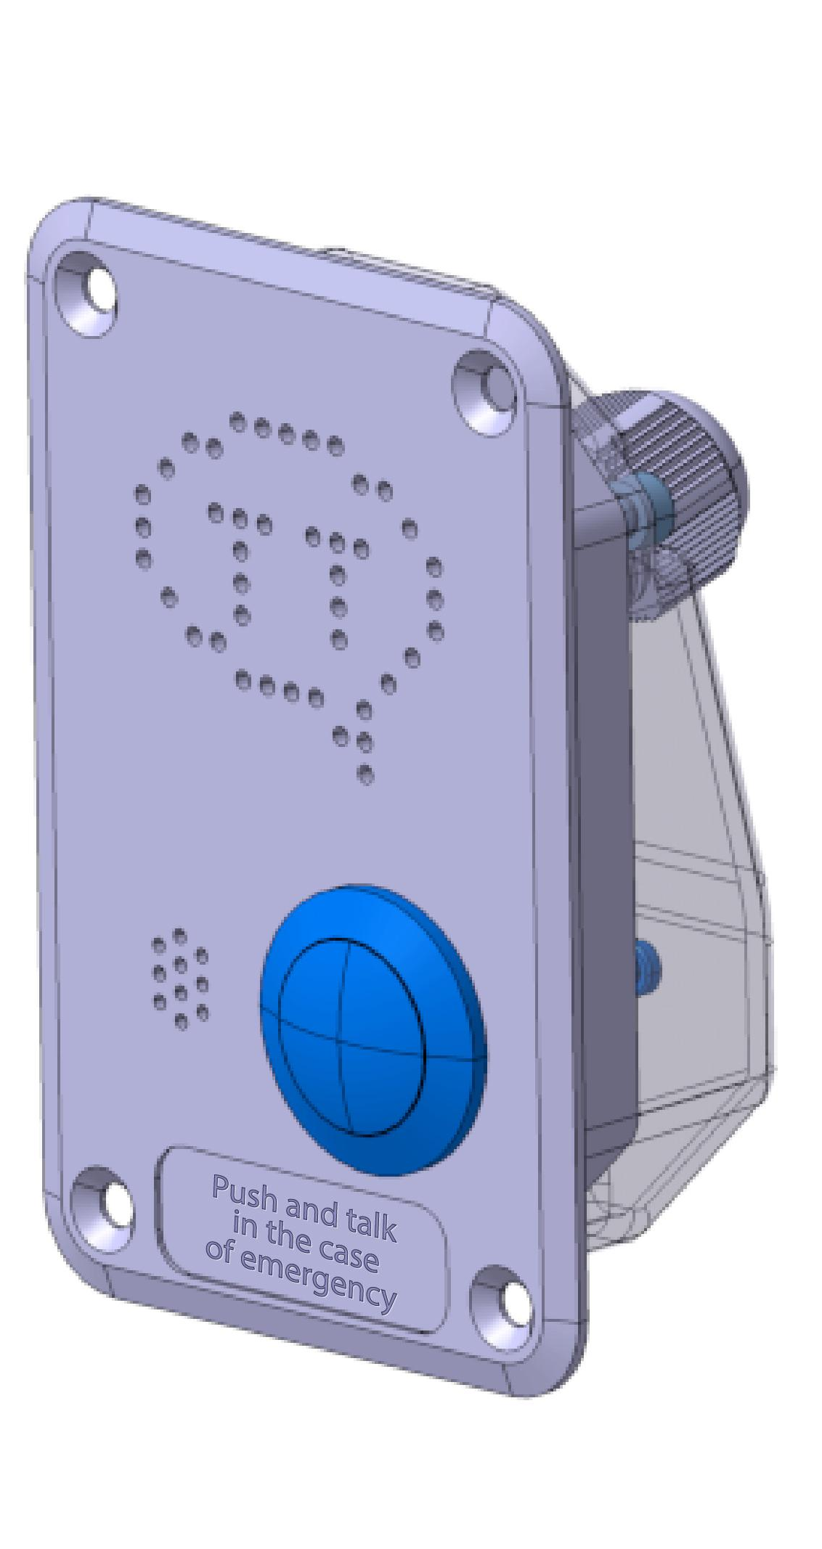
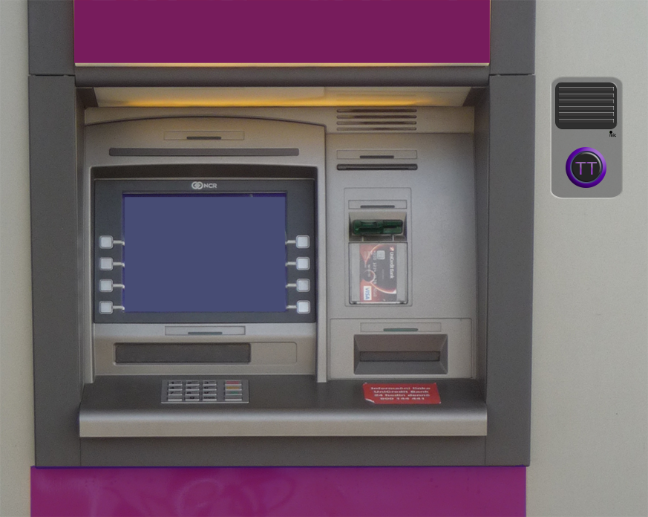
TreeTalk Ecosystem.
Communication module.
Push-to-talk
Talk button
www.Tree-Talk.com
www.tree-talk.com | twitter.com/TreeTalkCom | info@tree-talk.com
Notes:
and an embeddable communication module for elevator, vending machine, ATM, self-service kiosk,

Slide 7
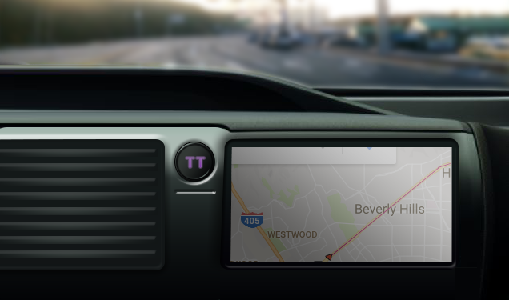
TreeTalk Ecosystem. Car button.
Push-to-talk
www.Tree-Talk.com
www.tree-talk.com | twitter.com/TreeTalkCom | info@tree-talk.com
Notes:
as well as an embeddable communication module for the unmanned vehicles and delivery robot

Slide 8
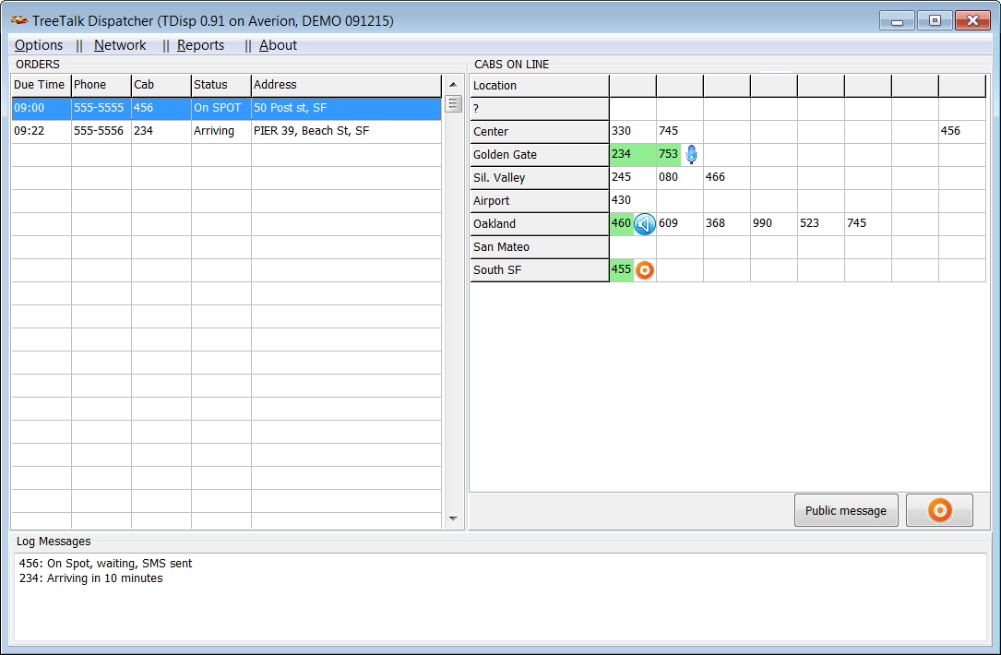
TreeTalk Ecosystem. Dispatcher Software.
www.Tree-Talk.com
www.tree-talk.com | twitter.com/TreeTalkCom | info@tree-talk.com
Notes:
The control software which is based on our protocols and technologies

Slide 9
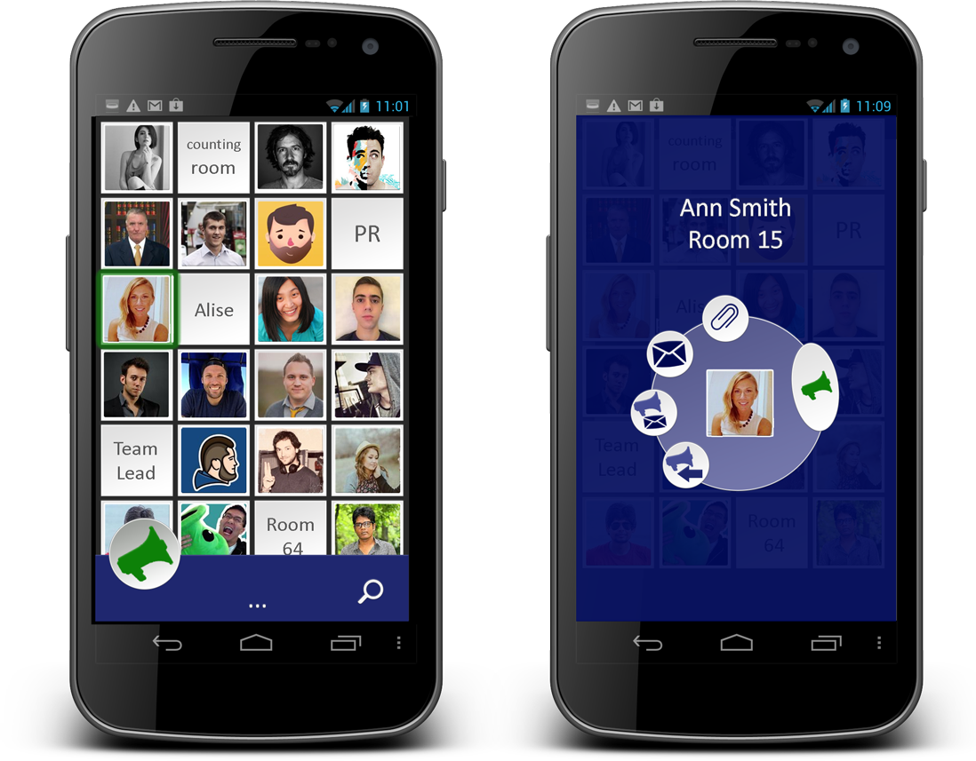
TreeTalk Ecosystem. Mobile App.
www.Tree-Talk.com
www.tree-talk.com | twitter.com/TreeTalkCom | info@tree-talk.com
Notes:
Mobile apps for instant voice calls in groups

Slide 10
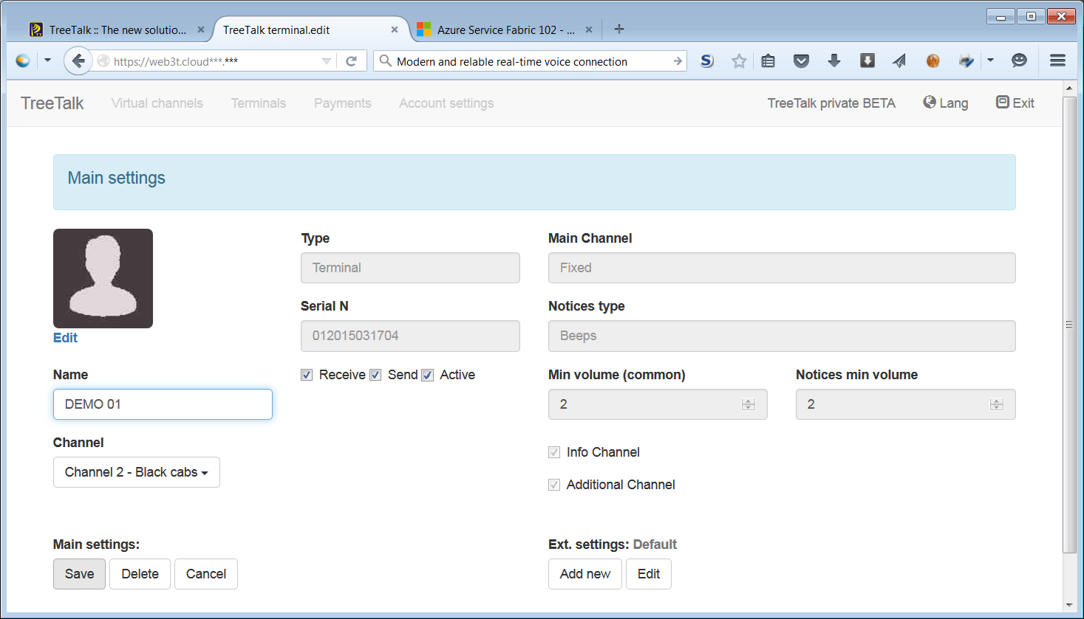
TreeTalk Ecosystem. Web Front End.
www.Tree-Talk.com
www.tree-talk.com | twitter.com/TreeTalkCom | info@tree-talk.com
Notes:
and the user web front end

Slide 11
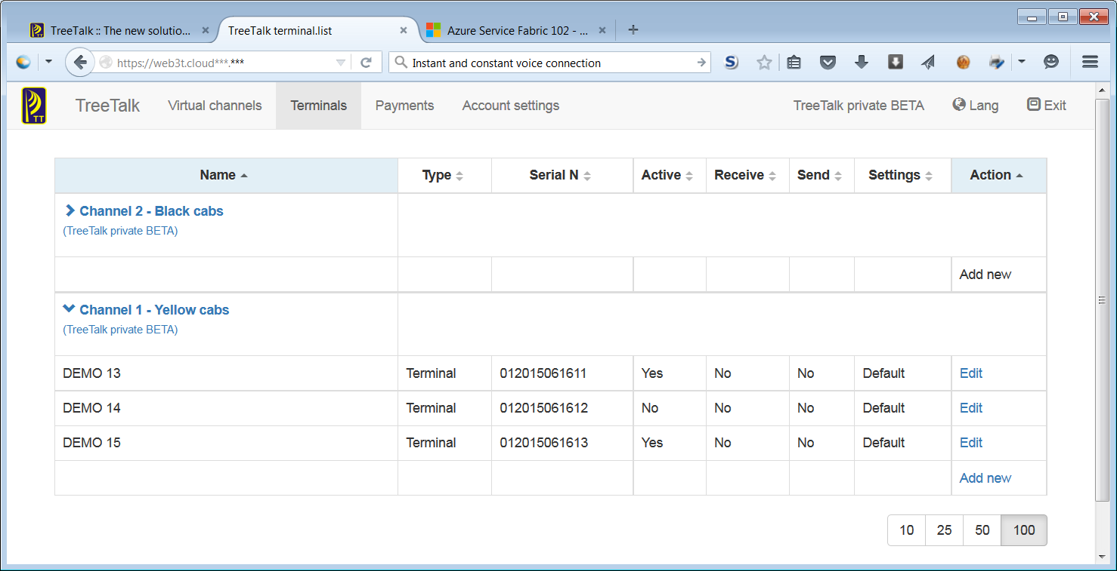
TreeTalk Ecosystem. Web Front End.
www.Tree-Talk.com
www.tree-talk.com | twitter.com/TreeTalkCom | info@tree-talk.com
Notes:
for combining devices and apps into dedicated channels

Slide 12
TreeTalk Telecommunications Ecosystem
Wireless
data
networks
TreeTalk Cloud
Address
server
Devices
Operator
software
Central
server
WEB
UI
Routing
servers
Mobile
app
Control
app
Intellectual Property registered: United States Patent N 9,338,275 RF UM Patent N 121411 PCT/RU2013/000062, WIPO WO 2013/162414 A1, US 2015/0072724 A1 + numerous know-hows...
www.Tree-Talk.com
www.tree-talk.com | twitter.com/TreeTalkCom | info@tree-talk.com
Notes:
It’s a pretty complex system (for us to build), however our end-users will enjoy devices in a familiar form factor

Slide 13
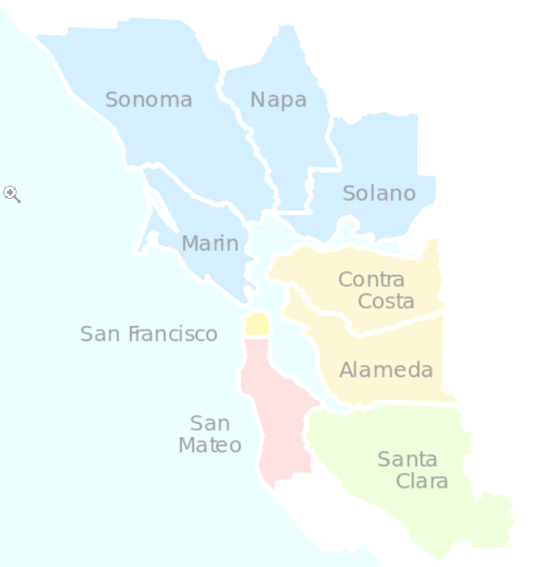
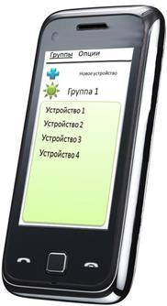
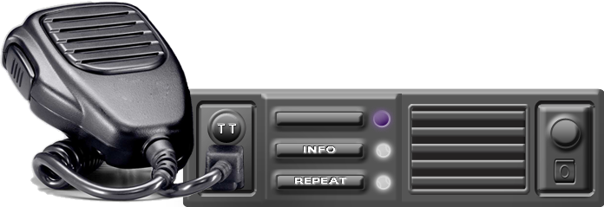
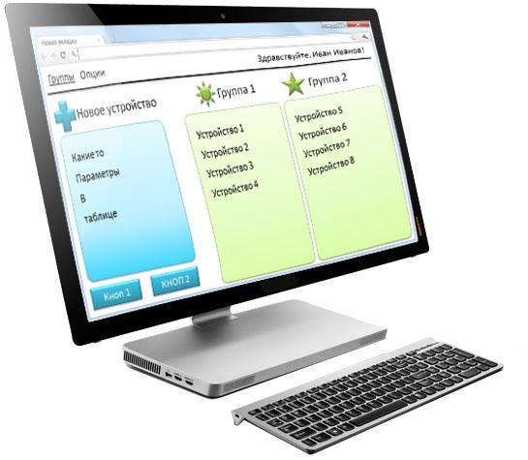
TreeTalk Ecosystem. Dispatcher mode.
www.Tree-Talk.com
www.tree-talk.com | twitter.com/TreeTalkCom | info@tree-talk.com
Notes:
Just push one button and talk to an operator or to a whole team depending on your choice

Slide 14
TreeTalk Ecosystem. Group call mode.
www.Tree-Talk.com
www.tree-talk.com | twitter.com/TreeTalkCom | info@tree-talk.com
Notes:
instantly

Slide 15
The Easy Way of a TreeTalk User
Start talking!
Buy the terminals
Create an account on the TreeTalk website
3 steps
Fast
Simple
www.Tree-Talk.com
www.tree-talk.com | twitter.com/TreeTalkCom | info@tree-talk.com
Notes:
avoiding connection time and delays

Slide 16
http://www.Tree-Talk.com
info@Tree-Talk.com
TreeTalk
Instant Voice Telecommunications
Welcome to the future of professional telecommunications!
Notes:
So welcome to the future of professional telecommunication.

