Slide 1




representative:
Igor Yanovskiy
TreeTalk
Instant Voice Telecommunications
Supported by:
Notes:
Good morning.
My name is Igor Yanovskiy and I'm a founder of TreeTalk.
TreeTalk is a startup, in which hardware, software and telecommunications become fused. In a nutshell - we are building a new global telecommunications ecosystem that works under the paradigm of constant connection and instant voice calls.

Slide 2
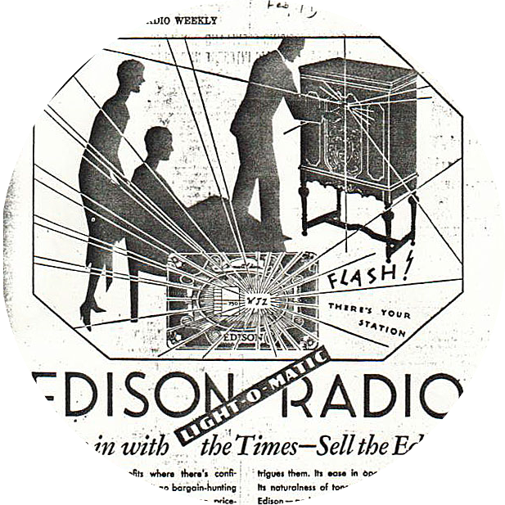
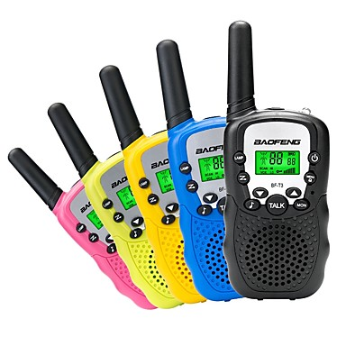
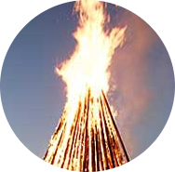
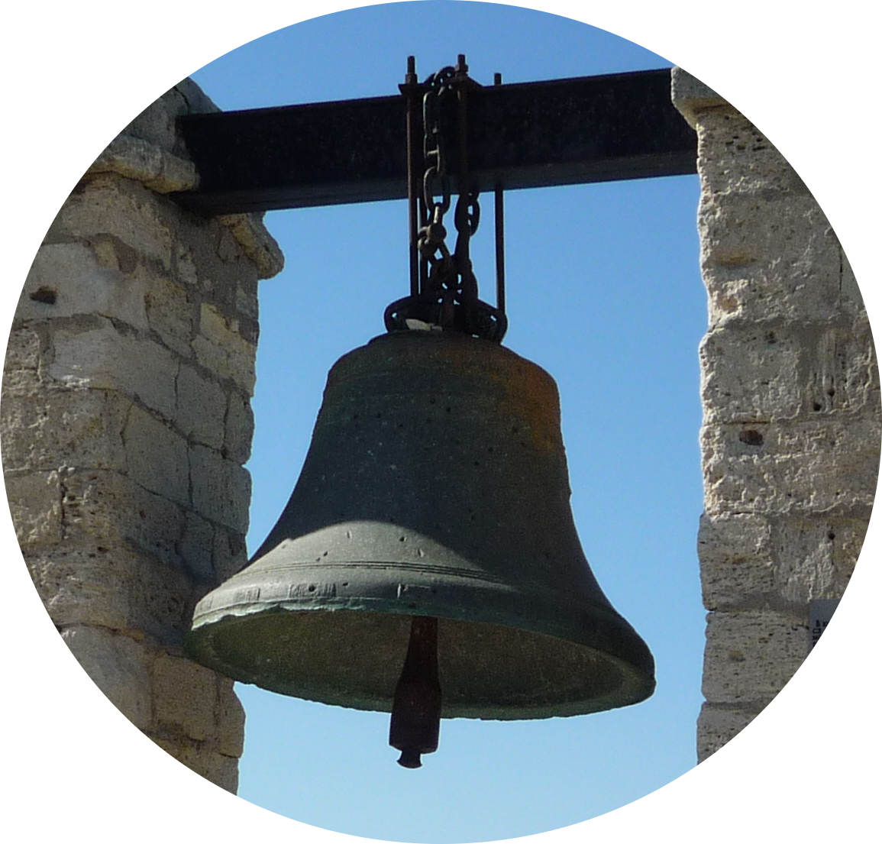
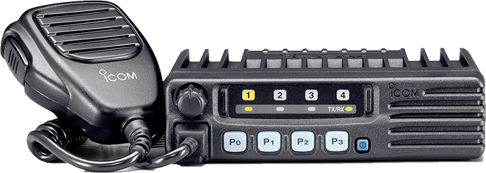
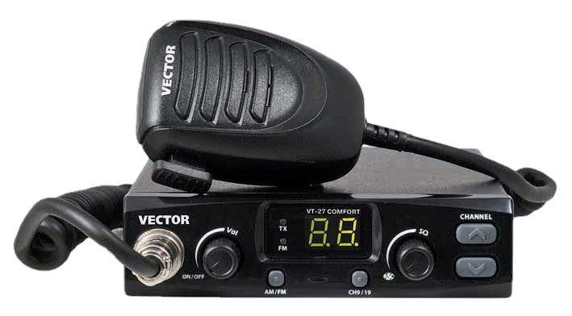
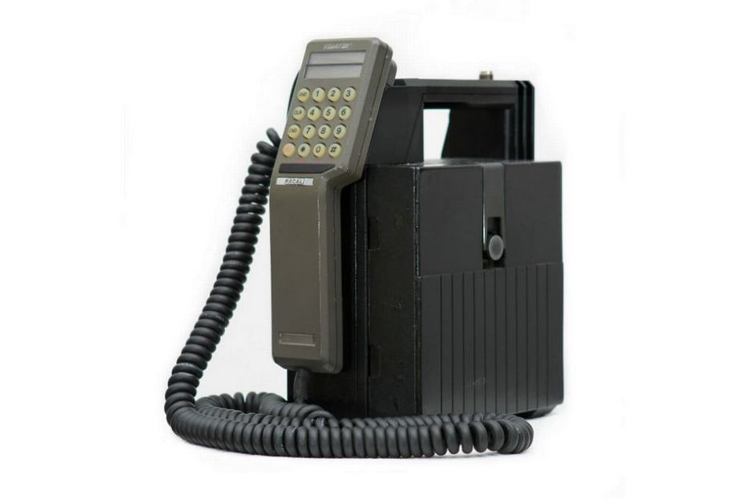
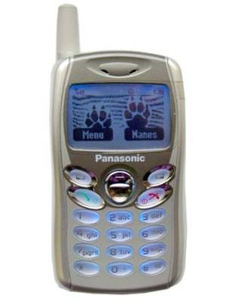
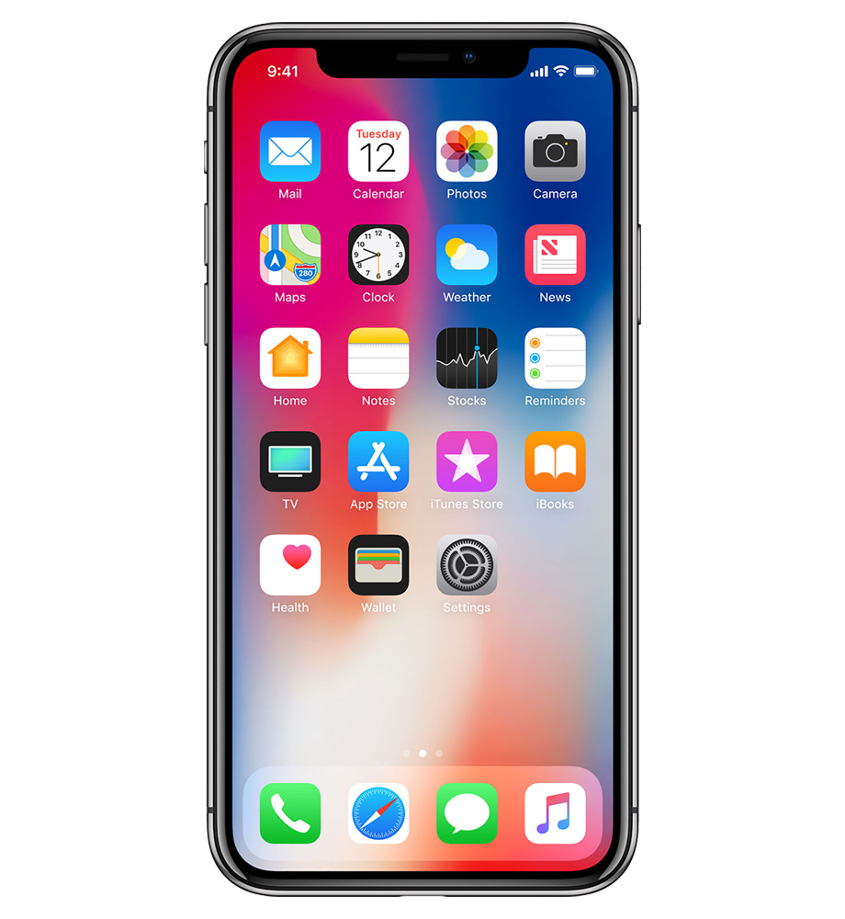
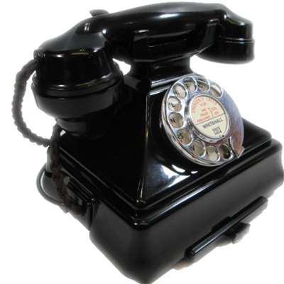


Evolution of the Telecommunications
Instant-call
Two-way radios
?
. . .
Session-mode
www.Tree-Talk.com
www.Tree-Talk.com
Notes:
First underlying idea that we follow, developing our system is that of...
People, from the ancient times, always need the means of communications that work in the instant-call paradigm (instead of session-mode paradigm used in telephones and messengers like Skype).
Sometimes, you just need to tell a couple of important words to your colleague or a whole team, or ask something, and, for that you have to open application, find contact, wait for connection, then speak a couple of seconds. Not very operative or productive, right?

Slide 3
Land Mobile Radio Flaws
Noise
Bulky antennas
Limited range of communication
Need for power amplifiers
Complex mounting, commissioning, and maintenance
www.Tree-Talk.com
www.Tree-Talk.com
Notes:
Barring a signal fire and tower bell, we have some other options. For instance, Two-way radios are popular in the field. But they have a number of flaws, such as a limited range of communication, a need for power amplifiers and bulky antennas, an unstable signal quality, and so on. At the moment, that's seriously limiting the area of their use.

Slide 4

Land Mobile Radio Sales
10 billion U.S. dollars
a year
www.Tree-Talk.com
www.Tree-Talk.com
Notes:
However, the target market segment ratings show at least 10 billion dollars of annual profit from sales of new devices, and growing.
Why have people being buying these expensive devices for 100 years, despite the existing solutions are based on the ridiculously outdated technology?

Slide 5
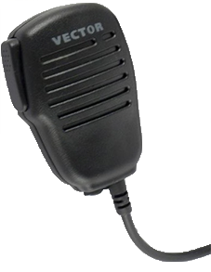
The Advantages of Radio
(and of TreeTalk too)
Instant connection
Broadcast
Push
&
Talk
Easiness
www.Tree-Talk.com
www.Tree-Talk.com
www.Tree-Talk.com
Notes:
Because of 3 simple advantages. First, it provides an instant connection. Second, it allows you to broadcast. Third, it is easy to use. Push one button and talk to one person or to the whole team immediately.

Slide 6
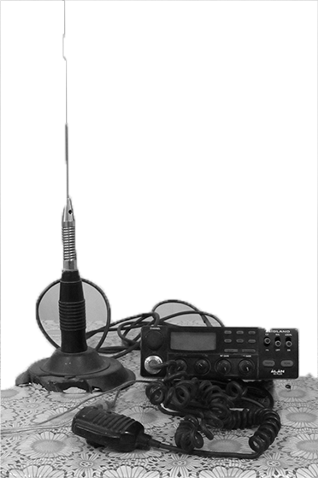
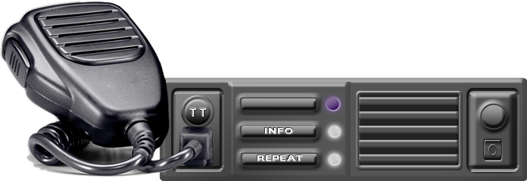
Pros & Cons
Traditional conventional systems
TreeTalk system
+ Simplicity
+ Broadcasting
+ Instant connection
+ Usability
+ Instant connection
+ Broadcasting
+ Duplex mode operation
+ No noise
- Noise
+ Extra features (GPS etc.)
- Limited range of
communication
+ Digital sound
- Complex mounting, commissioning, and maintenance
+ Selective call
+ Flexible groups
- Power amplifiers
- Bulky antennas
www.Tree-Talk.com
www.Tree-Talk.com
Notes:
We are going to carefully transplant the advantages onto a new technical platform, avoiding the flaws.
It makes no sense to build primitive infrastructure for each new voice channel (as LMR users still do), while modern networks cover 90 percent of the world population.
Noise, Antennas, Officials? No more!

Slide 7

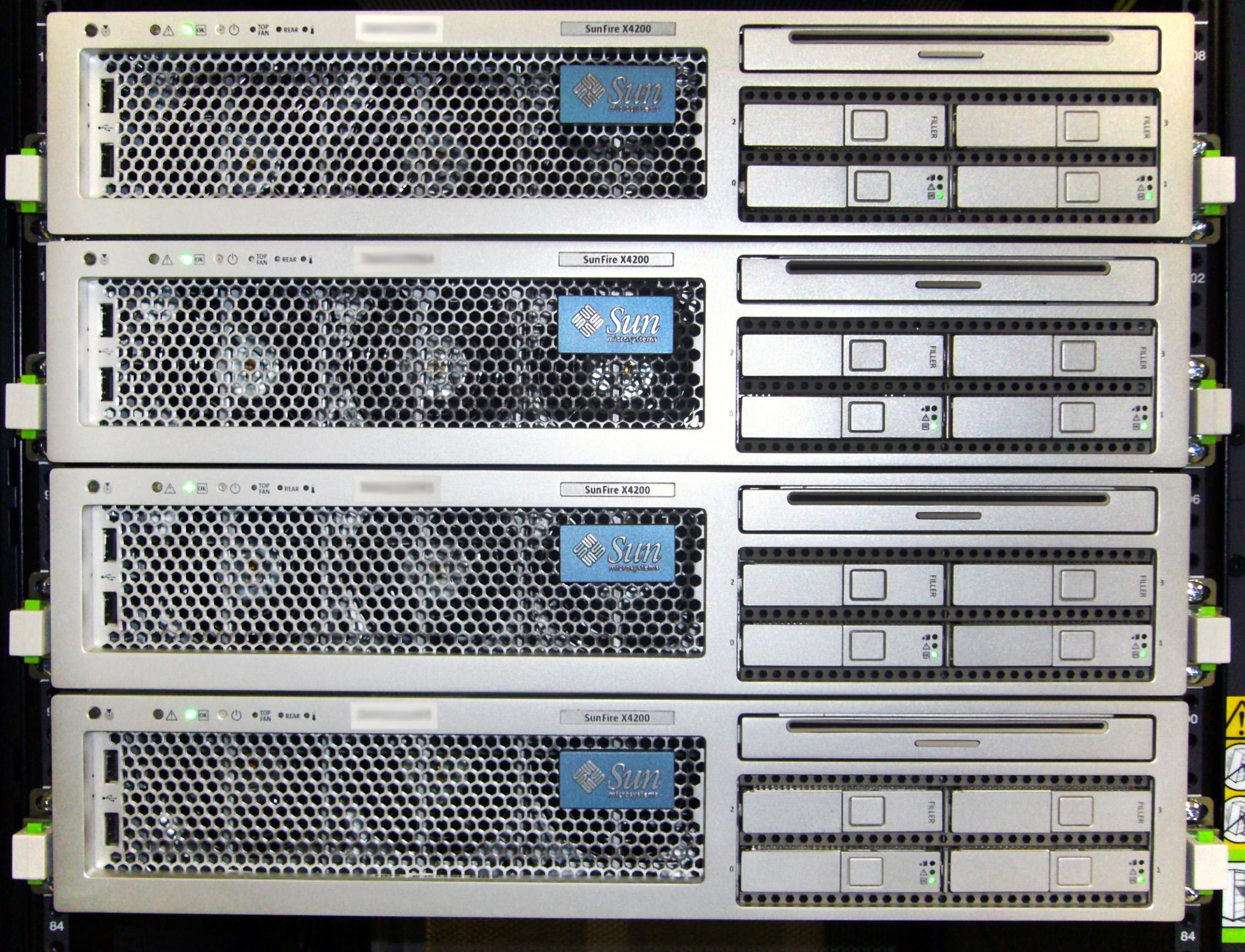
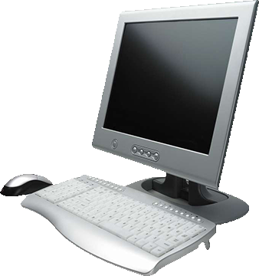
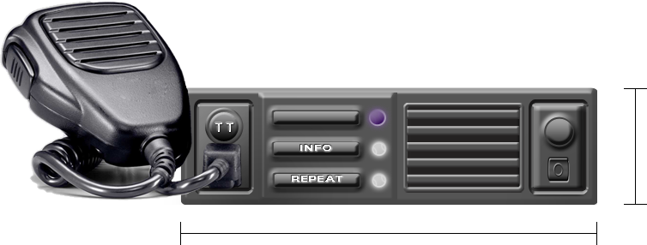
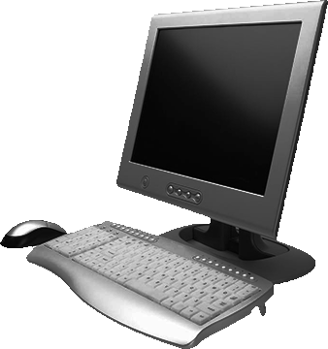
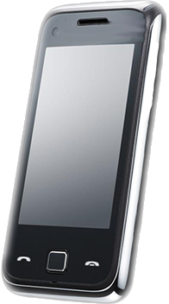
TreeTalk Telecommunications Ecosystem
WIRELESS DATA NETWORKS
TreeTalk Cloud
Address
server
Devices
Operator
software
Central
server
WEB
UI
Routing
servers
Control
app
Mobile
app
Intellectual Property registered:
United States Patent N 9,338,275
RF UM Patent N 121411
PCT/RU2013/000062, WIPO WO 2013/162414 A1, US 2015/0072724 A1
+ numerous know-hows...
www.Tree-Talk.com
www.Tree-Talk.com
Notes:
We digitize sound, compress and transfer it (without loss) to other devices, to their groups and to compatible hardware and software systems, using the resources of modern data networks as a reliable and affordable data transport medium. We've developed and patented voice compression and transmission technology, which allows us to use even the narrow-band mobile networks of 2-3 generations.
The entire system, beside the devices, mobile apps and control software, comprises a web front-end, back-end, databases and servers for addressing and routing.

Slide 8
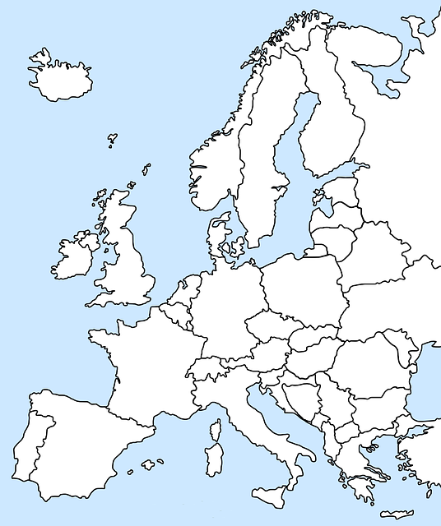


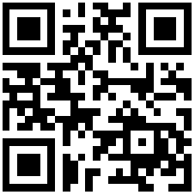
GDPR Compliance
TreeTalk platform instances deployed
Moscow, Russia
Nuremberg, Germany
panel.tree-talk.com
Login: demo
Password: demo12345
www.Tree-Talk.com
www.Tree-Talk.com
Notes:
At the moment, we have deployed instances of the platform in 2 locations in Eastern and Western Europe, in order to comply the personal data protection laws of RF and EU respectively.
By the way, feel free to visit the demo account.
(https://panel.tree-talk.com . Sign-in login: demo , Password: demo12345 )

Slide 9



The Difficult Way of the LMR User
1. Acquire frequencies
(except CB)
2. Buy the transceivers,
antennas, PSU
3. Find a good place on
the hill for office
4. Mount the
antennas and cables
5. Tune the SWR,
program the
transceivers
6. Hire a maintaining
professional
7. Start talking
www.Tree-Talk.com
www.Tree-Talk.com
Notes:
In addition to all the advantages of digital cloud technology, our solution is more user-friendly.
Typical user of conventional two-way radio technology face a bunch of problems: regulations, limitations, barriers during frequency acquisition, complex commissioning and costly maintenance.

Slide 10
The Easy Way of a TreeTalk User
Start talking!
Buy the terminals
Create an account on the TreeTalk website
3 steps
Fast
Simple
www.Tree-Talk.com
www.Tree-Talk.com
Notes:
Our solution is complex inside, but is very simple for the end users. Buy a device, create the group via web front-end, and get connected.
Enjoy a new technology in a familiar form-factor!

Slide 11
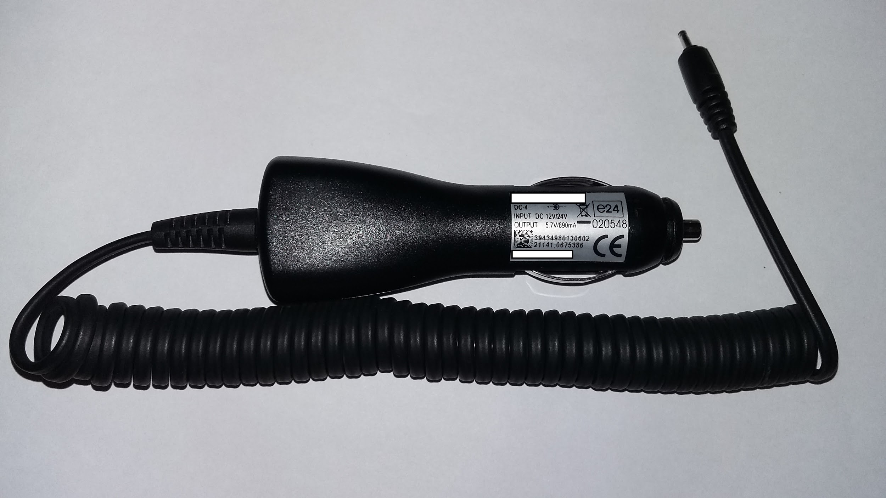
The Terminal One
50* mm
178* mm
PS unit
12V/24V
Repeat button
* ISO 7736 / DIN 75490 compliance
www.Tree-Talk.com
www.Tree-Talk.com
Notes:
Our business model is traditional and comprises 3 basic components: sales of physical product, software, and services.
First, we will produce and sell our devices. Customers know, that professional telecommunication devices are expensive - up to 1,000 Euro each. At the same time, they are realizing that the systems they use now are outdated and have many drawbacks. We will eliminate those drawbacks. Our devices have new useful features. So, we can assign a good fair price for them, and, in the same time, we are able to make them cheaper than competitors.

Slide 12
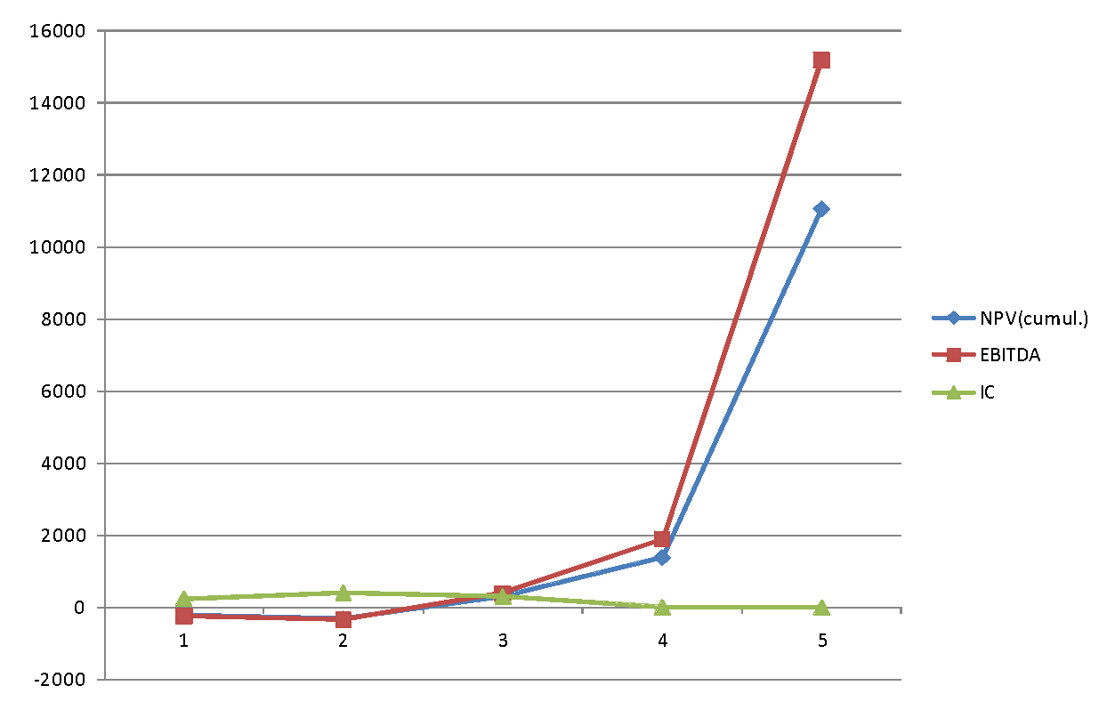
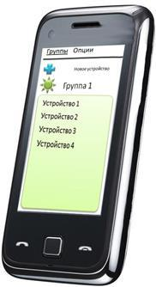

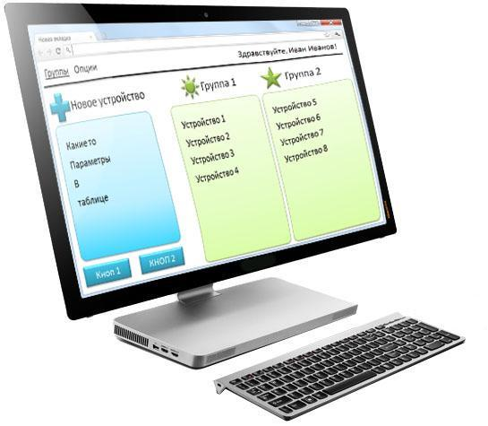
Financial Model
Payback period | 3 years
NPV | $8.3M
IRR | 166 %
Initial addressable market | $2B / y
Total addressable market | $10B / y
kUSD
Sales of our web-services
$5 / mo
Current point
Sales of our software
years
Sales of our devices
$249
$99
www.Tree-Talk.com
www.Tree-Talk.com
Notes:
Also, we will sell PC and mobile applications based on our platform.
We will provide a web front-end for combining gadgets and apps into dedicated channels.
Plus, we are creating a new medium for geo&context-targeted advertising.
And. The protocol, which we developed initially for communication among the our devices and apps, appeared versatile enough for using not only for that. Besides the personal and group calls, it allows to send and receive files, pictures, setup packages, and remote control commands, in real time. Thus the platform may be used for a variety of other applications, including: collection data from connected devices and sensors, connection between IoT hubs and end-user software, etc. These resources may be used by third-parties as well, thanks to our modest and flexible tariffs.

Slide 13
Market Fit and Competition
 | Digital sound quality | Сheap exploitation | Quick launch | Spectral efficiency | Coverage area
TreeTalk | V | V | V | V | V
Analog radios / intercoms |  | V
Digital radios | V | V
Digital trunked systems | V |  |  |  | V
www.Tree-Talk.com
www.Tree-Talk.com
Notes:
Looks good. But our main market advantage is that: we are new and highly innovative, but we are not dreaming up any new market. There is a huge niche in the B2B segment already, large and growing. We just offer an effective and convenient solution to meet the existing needs of traditional and prospective (which is more) users of real-time voice telecommunications. We believe - game-changing solution.

Slide 14
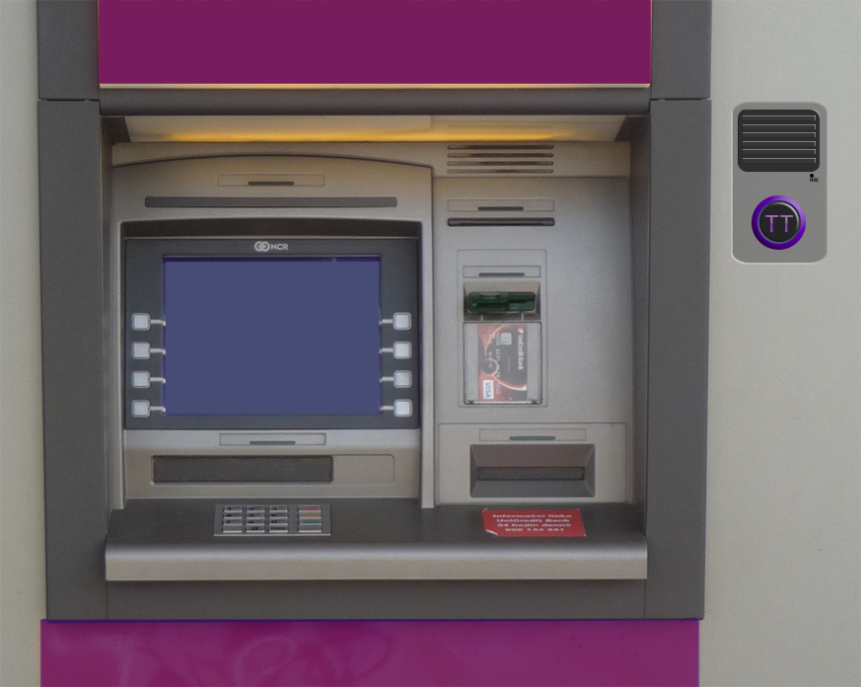
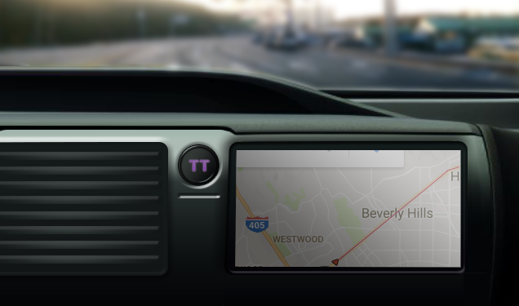
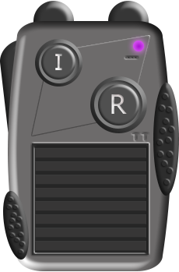
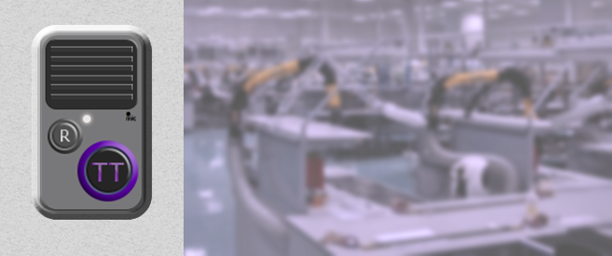
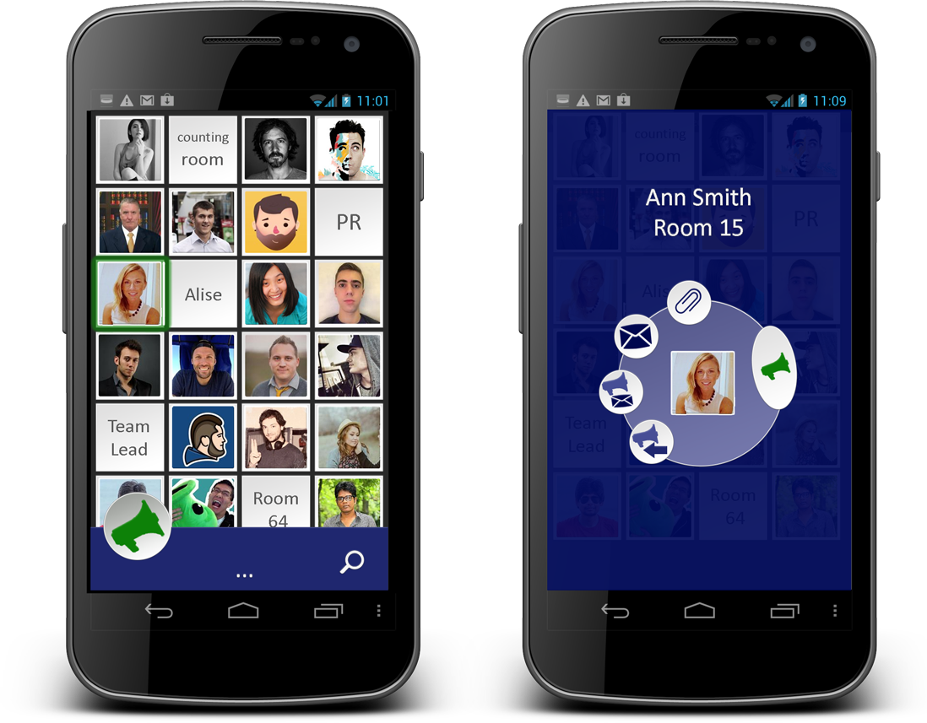
Product Line Expansion (in development)
Wireless intercom modules
Handheld Communicator
Instant-call Messenger
www.Tree-Talk.com
www.Tree-Talk.com
Notes:
On the next step, our universal platform and modular electronics design will allow us to expand the product line and rapidly branch out into adjacent niches that also require a permanent connection and high-quality voice communication: hand-held communicators, communication modules for ATM, parking meter, self-service kiosk, elevators, and so on.
For example, if an ATM swallows a card, or the vending machine is acting up, nowadays you have to find a hotline phone number, to call, to wade through annoying ads and "press 1 for this, press 2 for that", then explain the problem to the service employee a long while. Instead, simply press a button and talk - TreeTalk connects instantly, and the operator is already known exactly where you are, and probably what happened.
Let's look into the nearest future. You definitely will see Big Button with Purple TT Sign on the dashboard of self-driving cab, taking you home. Because even if algorithms, controlling the autonomous vehicle, look ideal, always there is a room for surprise in the real life. So the people inside and, maybe, outside the vehicle must have the opportunity of instant voice connection to the dispatcher / control tower / support.
Afterward, imagine a goofy delivery robot obtruding the wrong sort of pizza, which you have not ordered -- you just may to push a similar button on it and immediately tell the operator what do you really think about Artificial Intelligence.

Slide 15
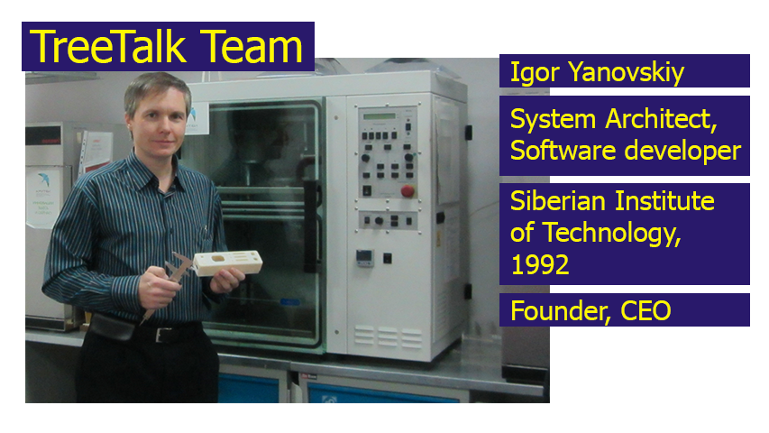
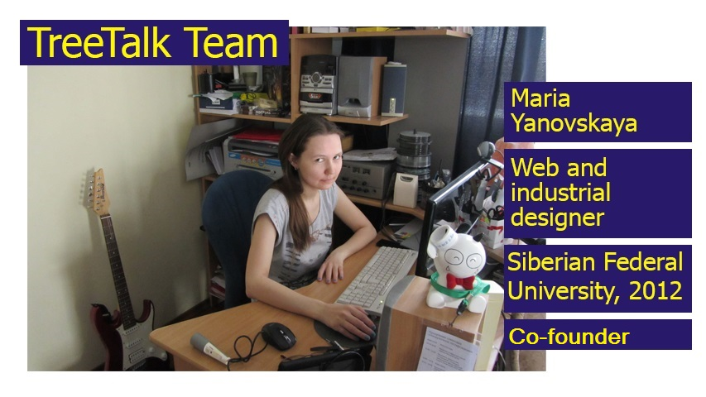
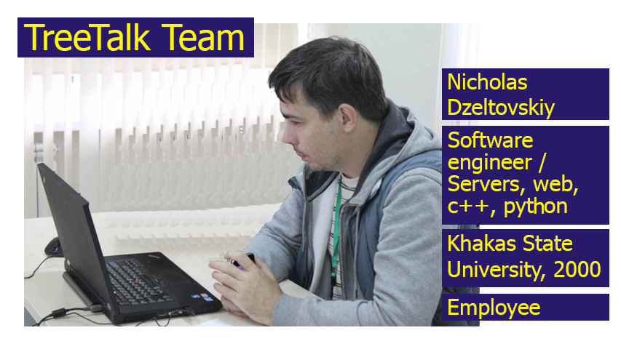
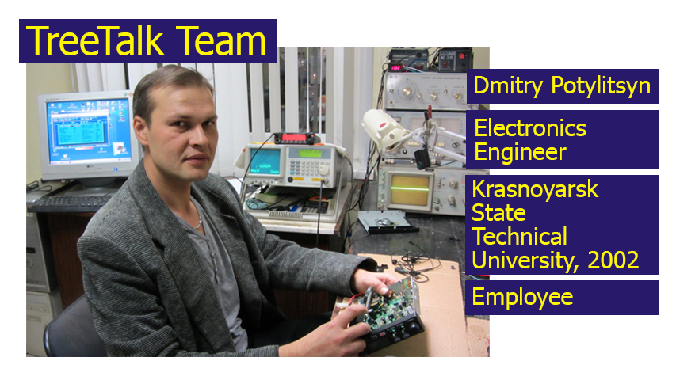
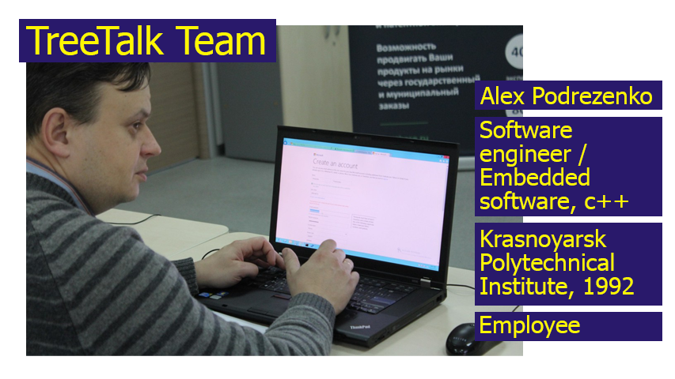
TreeTalk Core Team
www.Tree-Talk.com
www.Tree-Talk.com
Notes:
For this startup I was fortunate to gather a team of highly educated professionals.
Dealing a long while with telecommunication gear, each of us always try to give our clients the best tools. But, one beautiful sunny Siberian day, we've realized that existing solutions have to be radically improved, and we finally came up with an idea of TreeTalk.
Since that time, We have done a lot, and we are able to achieve our goals. No doubt.

Slide 16
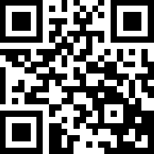
http://www.Tree-Talk.com
info@Tree-Talk.com
TreeTalk
Instant Voice Telecommunications
Welcome to the future of professional telecommunications!
Notes:
We believe - Our solutions will change the face of voice telecommunications, making it more modern and convenient.
Thank you for your attention.
And welcome to the future of professional telecommunications.

Slide 17
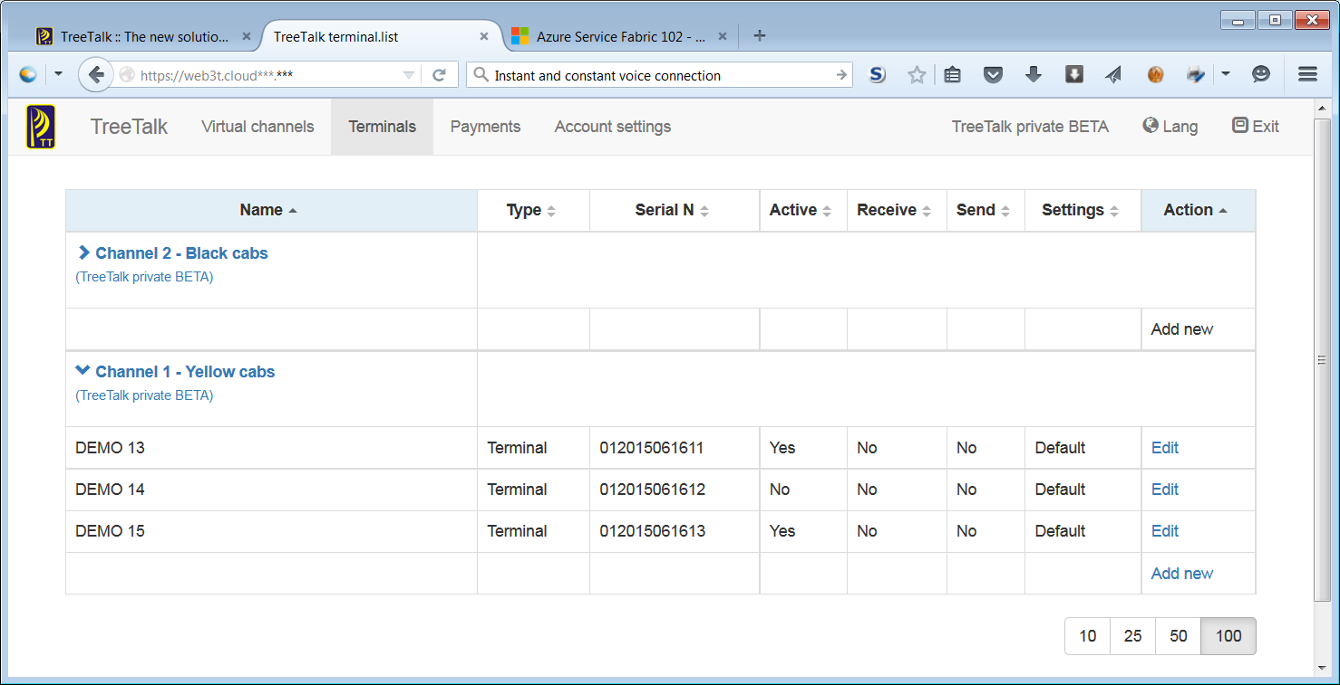
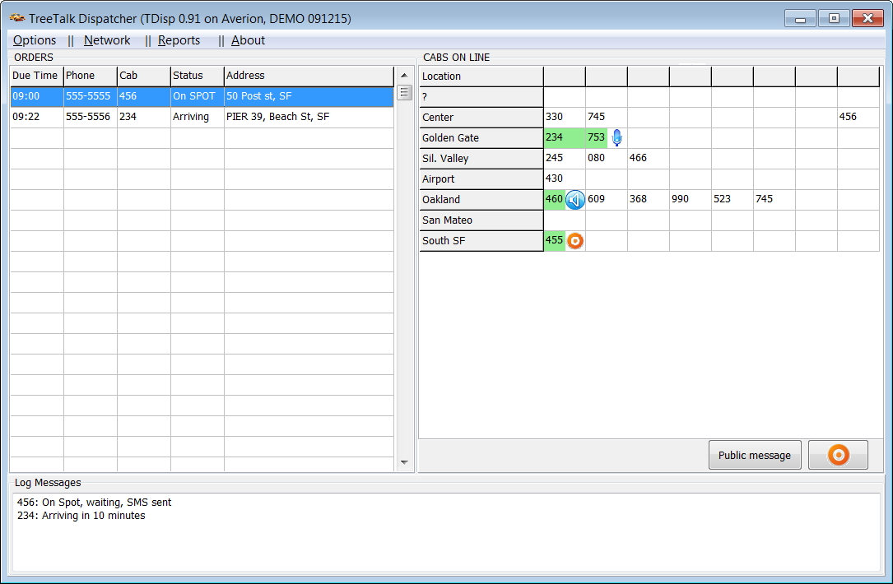
Appendixes
User interface
Prototype of dispatcher’s app
www.Tree-Talk.com
www.Tree-Talk.com
Notes:
Initially, we built our cloud platform as an engine for the devices. We just tried to revolutionize the industry of two-way radios, like, say, an iPod in its time has revolutionized the industry of music players. There are several parallels here: old-fashioned CC and CD music players was a) personal and b) offline, as conventional radios still are; we are moving technology into the cloud, and we use the network as a transport medium too (like iPods and iTunes store began to do years ago).

Slide 18
Financial Projections
Capital required to obtain the positive cash flow | $0.45M
Capital required to break-even | $1.2M
Initial addressable market | $2B / year
Total addressable market | $10B / year
Сustomer lifetime value (3-year basis) | $280
Payback period | 3 years
www.Tree-Talk.com
www.Tree-Talk.com
Notes:
FUNDING:
Basically our model is BOOTSTRAPPING
We constantly invest in TreeTalk the money that comes from our other profitable projects: Communication Systems (2491040.ru) and Ruspo (ruspo.com).
$49,150 is invested to date.
Additionally, we have won the national contest "START" and got $30k grant for the R&D, 3-year supporting program for R&D is also possible: up to $40k (2nd year) + $60k (3rd year).
We are planning to engage equity funding in "smart money" form (angel investor or VC firm, really interested in our business development) in order to increase development speed and get to early commercialization phase faster.

Slide 19
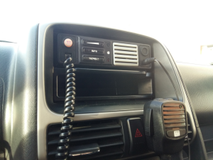
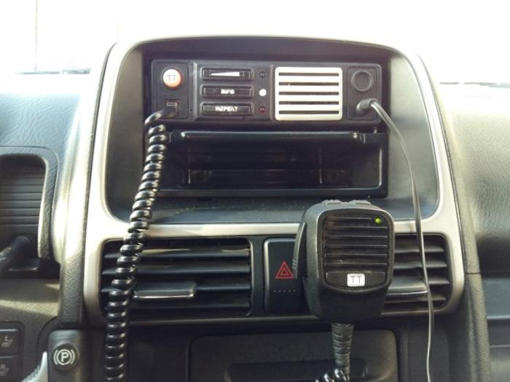
Field Tests
http://tree-talk.com/wp/
www.Tree-Talk.com
www.Tree-Talk.com
Notes:
Now, prototypes are being tested in the cars, which is riding around the city and near suburbs in a mode of normal use.

Slide 20
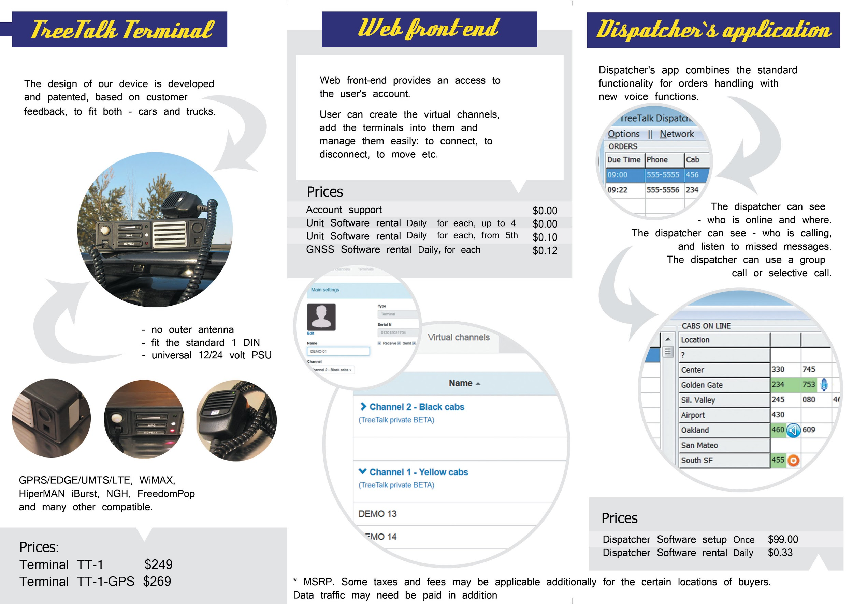
TreeTalk Leaflet / Projected Prices
www.Tree-Talk.com
www.Tree-Talk.com
Notes:
Our business model and market proposal can look more clearly from the prices in the leaflet.

Slide 21
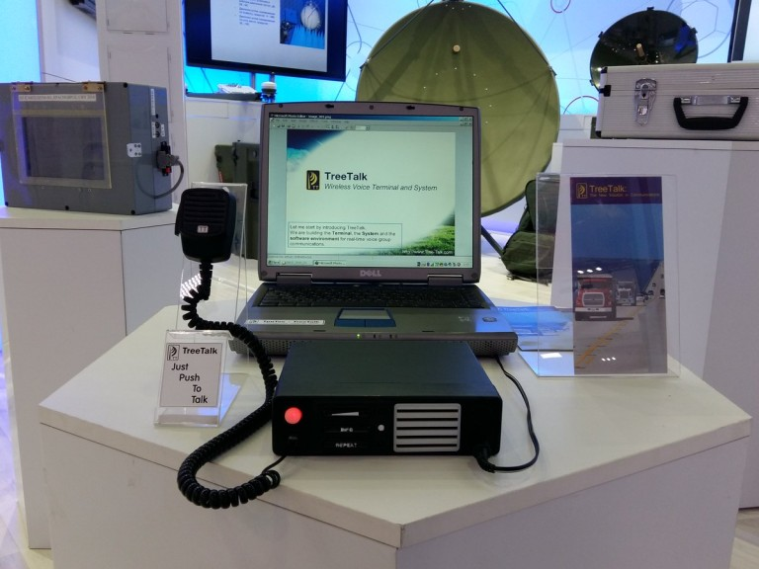
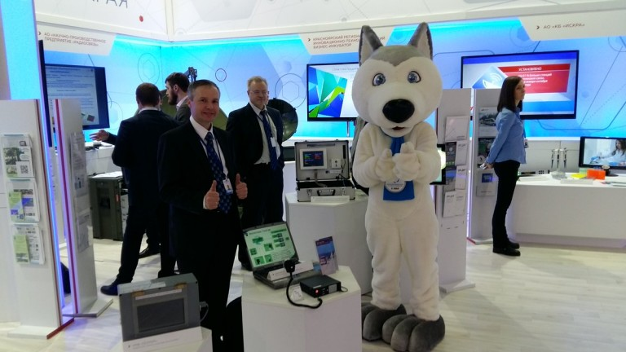
Market Research - Economic Forum
http://tree-talk.com/wp/
www.Tree-Talk.com
Notes:
TreeTalk took part in that huge event that gathered more than 6000 participants from different countries. Our b2b project fitted well to the format of the event. That allowed us to make a lot of contacts and to proof our ideas.

Slide 22


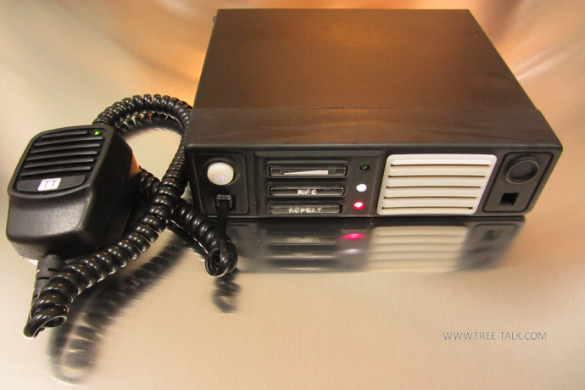
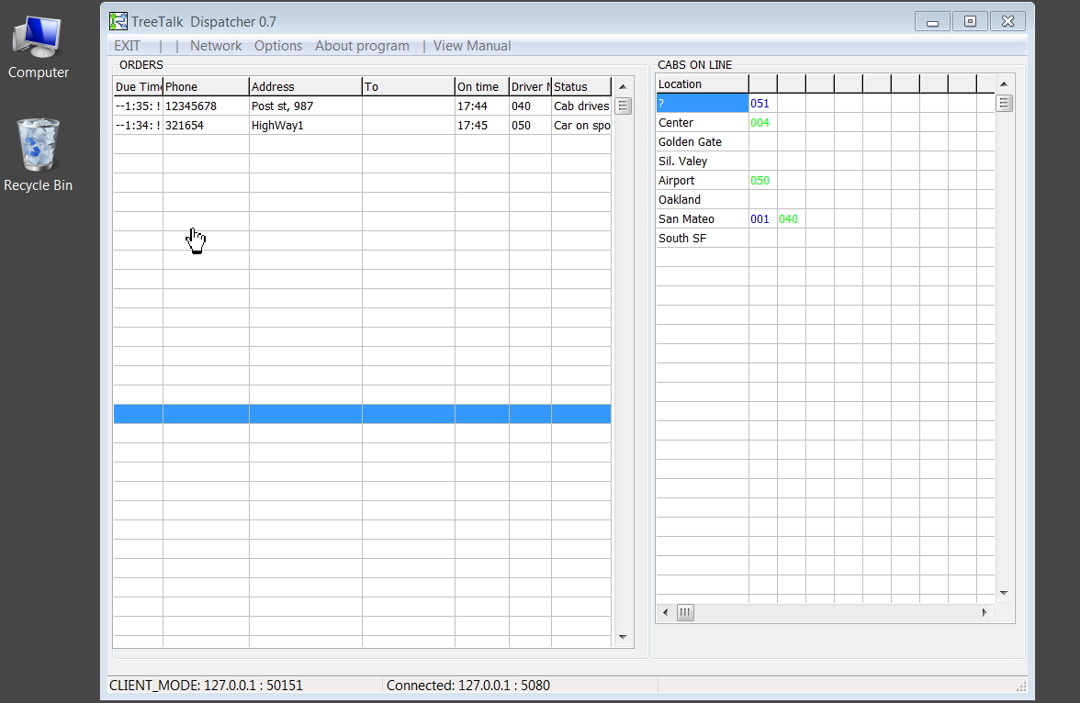
Traction and Plans
July 2014: Investment of founder.
Dec 2014: Grant for R&D has been won in the “Start” contest.
Apr 2015: First working prototype of the Terminal is ready.
May 2015: First prototype of the dispatcher's software is developed.
Feb 2016: The first R&D study, funded by FASIE, was finished.
May 2016: U.S. Patent N 9,338,275 was issued.
Feb 2017: Field tests of the communicator, Web UI and server infrastructure.
2018 Q2: Web UI and server infrastructure. Pilot batch of terminals.
2019 Q1: Final version of the Terminal One ready for production.
www.Tree-Talk.com
www.Tree-Talk.com
Notes:
At present, stage is R&D, more precisely - Private Beta stage, we prove our concepts, iterate.
We have a workable prototype of device, control app and cloud infrastructure. We conducted market research, surveys, and participated in international forums to fit the market demand.
We have finished first R&D study, thanks to the grant, which we won in national FASIE's Start contest for innovative startups.
Numerous Know-Hows and R&D reports are registered by citis.ru.
Latest inventions and patent granted:
Terminal Network for Wireless Voice Communications - US patent 9,338,275 B2 (May 2016);
Terminal for Wireless Voice Communications - RF UM Patent 121411, PCT/RU2013/000062.

