Slide 1
representative: Igor Yanovskiy
TreeTalk
Wireless Voice Terminal and System
supported by:
Let me start by introducing TreeTalk.
We are building the Terminal, the System and the software environment for real-time voice group telecommunications.
http://www.Tree-Talk.com
Notes:
Hello.
My name is Igor Yanovskiy and I'm a founder of TreeTalk.
Our solutions belong to the field of professional real-time voice telecommunications.
‹#›

Slide 2
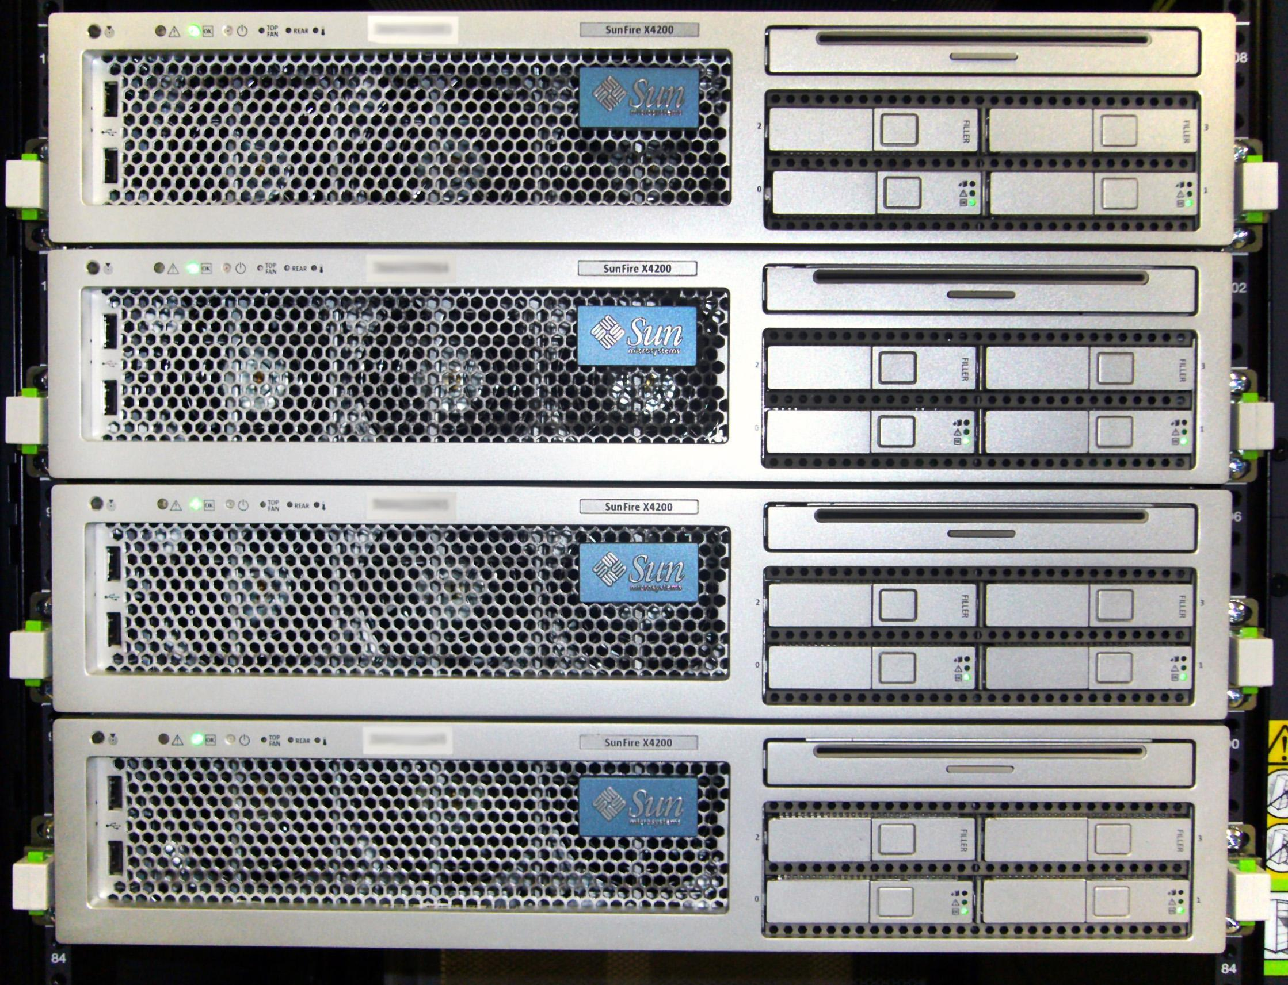
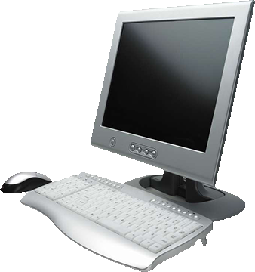
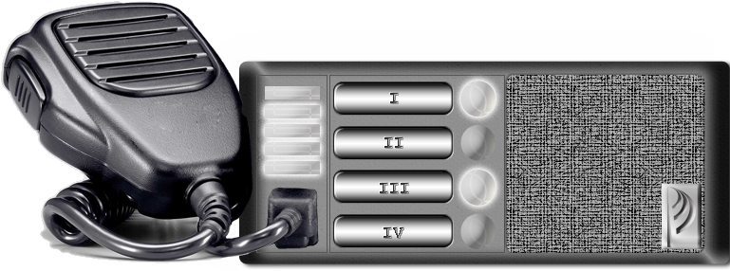
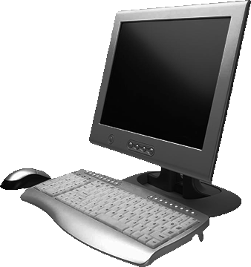
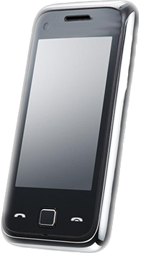
TreeTalk Telecommunications Ecosystem
TreeTalk Cloud
WIRELESS DATA NETWORKS
Address
server
Central
server
WEB
UI
Operator
software
Terminals
Routing
servers
We are creating a new class of mobile devices and a new global telecommunications ecosystem that works under the paradigm of constant connection and instant voice calls.
Control
app
Mobile
app
www.Tree-Talk.com
Notes:
People really often need the devices working under the instant-call paradigm (instead of session-mode paradigm used in telephones and messengers like Skype etc). It makes no sense to build primitive infrastructure for each new channel, while modern networks cover 90 percent of the world population.
So we digitize sound, compress and transfer it (without loss) to other devices, to their groups and to compatible hardware and software systems, using existing wireless data transport environments. We've developed voice compression and reliable transmission technology, which allows us to use even the narrow-band mobile networks of 2-3 generations.

Slide 3
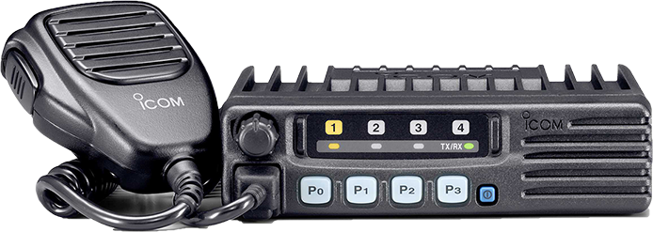
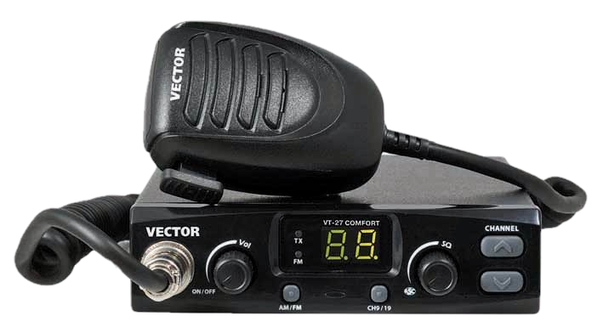
Land Mobile Radio Flaws
- Noise
- Bulky antennas
- Limited range of
communication
- Need for power amplifiers
- Complex mounting,
commissioning,
and maintenance
First, we have addressed the problems of the low-cost segment of the LMR market.
www.Tree-Talk.com
Notes:
First, we have addressed the problems with the low-cost segment of the Land Mobile Radio market.
Conventional and trunked radios, which people use now, have a number of flaws, such as:
a limited range of communication, a need for power amplifiers and bulky antennas, an unstable signal quality, and so on.

Slide 4
Land Mobile Radio Sales
2 billion U.S. dollars
a year
Despite those flaws, segment ratings show a growing annual profit.
www.Tree-Talk.com
Notes:
However, segment ratings show at least 2 billion dollars a year profit from sales of new devices.

Slide 5
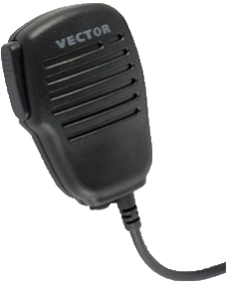
The Advantages of Radio (and of TreeTalk too)
Why have people been buying these pricey radios for 100 years?
Instant connection
Broadcast
Push
&
Talk
Because of those 3 simple advantages!
Easiness
www.Tree-Talk.com
Notes:
Why have people been buying these pricey radios for 100 years? Because of 3 simple advantages.
It allows you to broadcast.
It provides an instant connection.
It's easy to use. Push one button and talk.
‹#›

Slide 6
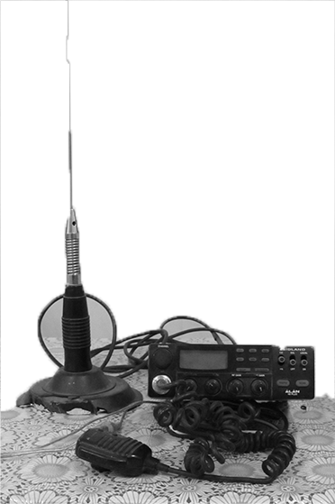
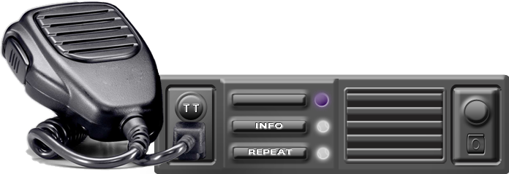
Pros & Cons
Traditional conventional radio
TreeTalk system
+ Broadcasting
+ Simplicity
+ Broadcasting
+ Usability
+ Instant connection
+ Instant connection
+ Duplex mode operation
- Limited range of
communication
+ Digital sound
+ No noise
- Noise
- Complex mounting, commissioning, and maintenance
+ Extra features (GPS etc.)
- Power amplifiers
+ Selective call
- Bulky antennas
+ Flexible groups
We are going to transplant the advantages onto the new technical platform.
www.Tree-Talk.com
Notes:
We're going to transplant these advantages onto the new technical platform.
Antennas? Сables? Boring paperwork with officials? NO MORE!
Clear sound, Public or selective calls, Simple commissioning, New features - Yes, sure!

Slide 7
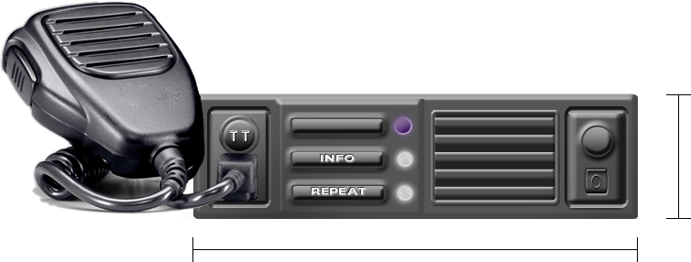
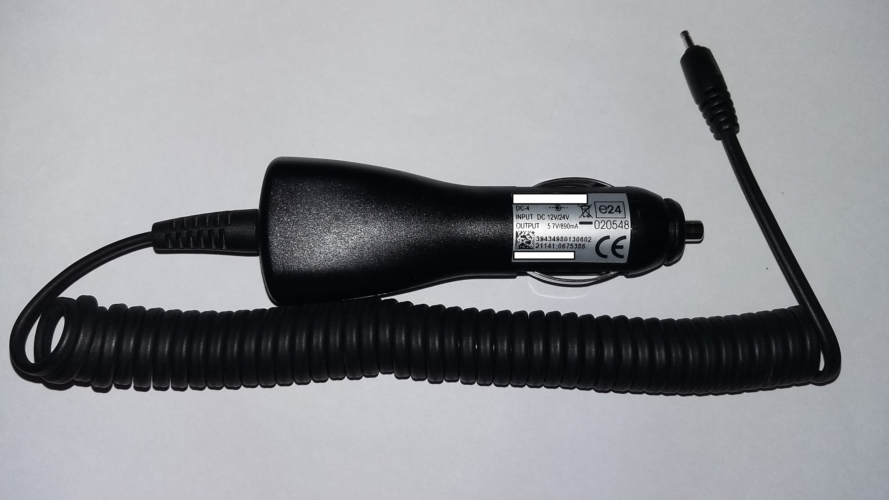
The Terminal
50* mm
178* mm
Repeat button
PS unit
12V/24V
* ISO 7736 / DIN 75490 compliance
** Intellectual Property registered: United States Patent N 9,338,275 RF UM Patent N 121411 PCT/RU2013/000062, WIPO WO 2013/162414 A1, US 2015/0072724 A1 + numerous know-hows...
www.Tree-Talk.com
Notes:
It's a pretty complex system - for us to build.
However our end users will enjoy devices in a familiar form factor and their lives and work will become much easier.

Slide 8
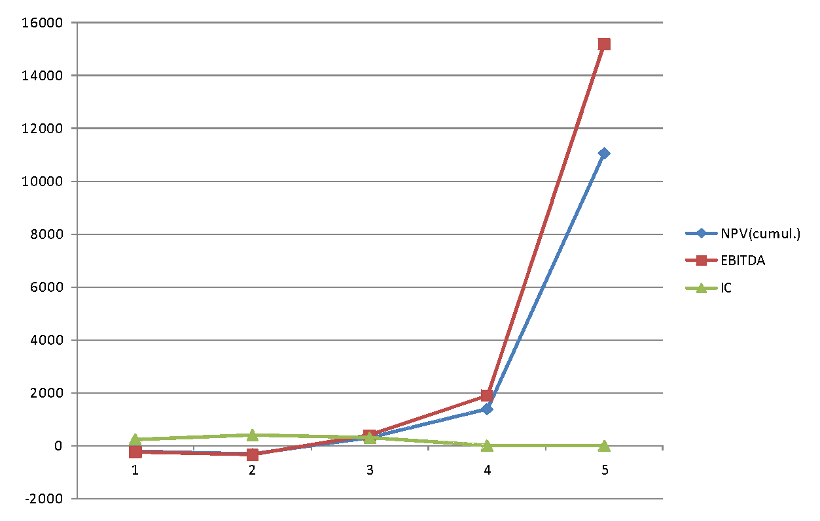
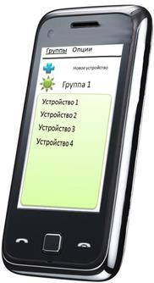
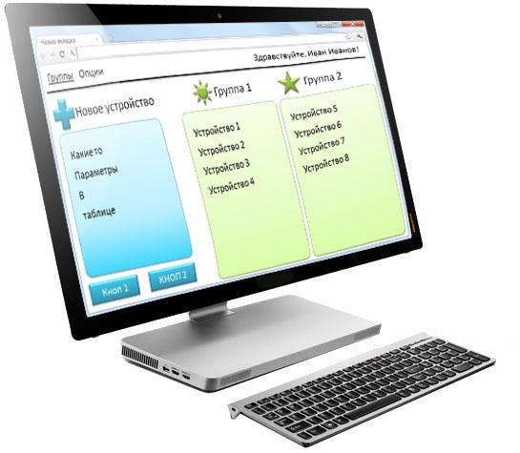
Financial Model
Payback period | 3 years
NPV | $8.3M
IRR | 166 %
Initial addressable market | $2B / y
Total addressable market | $10B / y
kUSD
Sales of our web-services
$5 / mo
Current point
Sales of our software
years
Sales of our devices
$99
$249
www.Tree-Talk.com
Notes:
Our financial model is quite traditional.
We will produce and sell the devices.
We will sell mobile apps, and control software based on our protocols and technologies.
We will also provide a web front-end for combining gadgets and apps into dedicated channels.

Slide 9
Market Fit and Competition
 | Digital sound quality | Сheap exploitation | Quick launch | Spectral efficiency | Coverage area
TreeTalk | V | V | V | V | V
Analog radios |  | V
Digital radios | V | V
Digital trunked systems | V |  |  |  | V
We offer a modern and convenient solution to meet the existing needs
of the customers. We have no direct competitors for our solution,
as there are no similar devices. Indirect competitors are worse.
www.Tree-Talk.com
Notes:
We are not dreaming up any new market.
There is a huge niche in the B2B segment already, developed and growing.
We offer a modern and convenient solution to meet the existing needs of the customers.

Slide 10
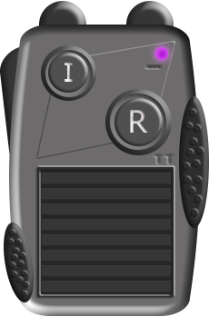
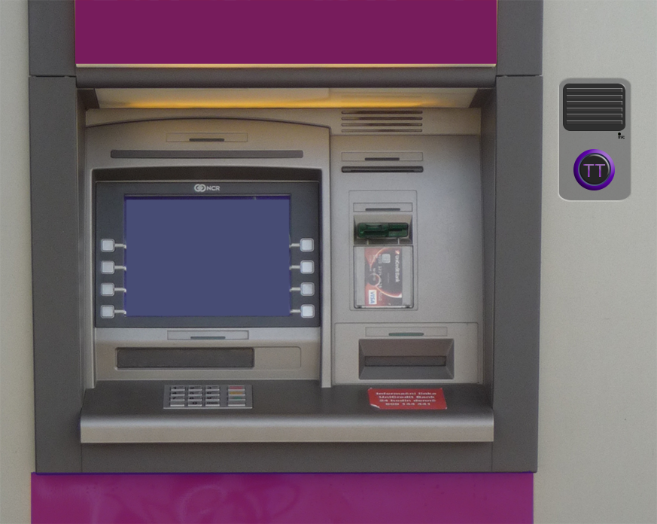
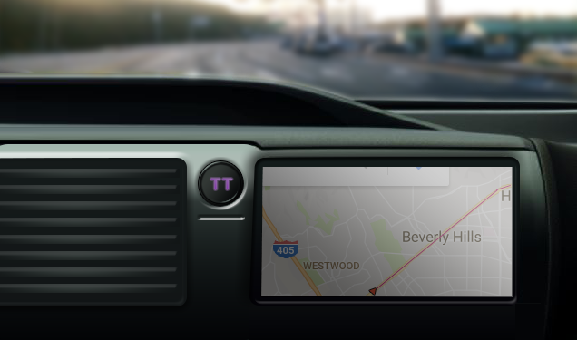
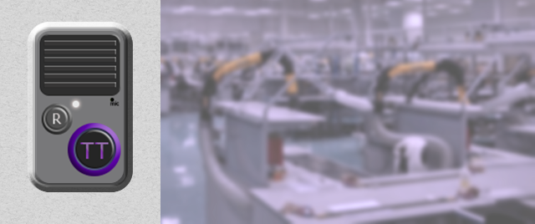
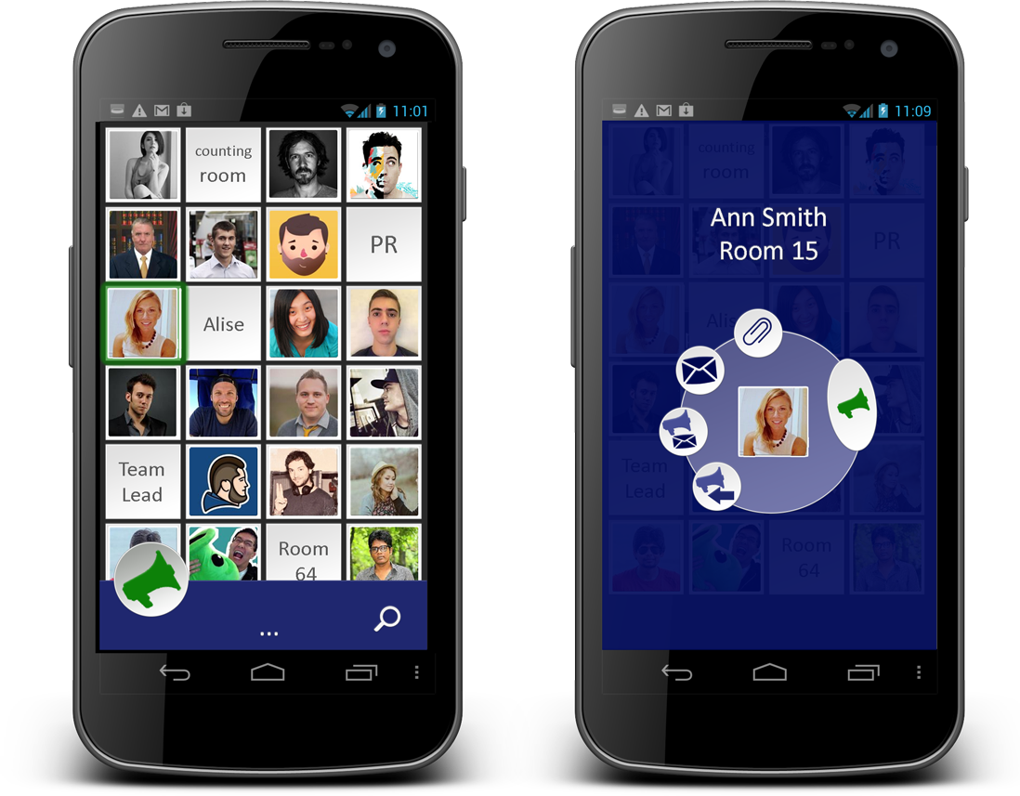
Product Line Expansion
Handheld Communicator
Wireless intercom modules
Instant-call Messenger
On the next step, we will expand the product line and rapidly branch out into adjacent niches. The existing TreeTalk platform allows us to do that faster.
www.Tree-Talk.com
Notes:
Modular electronics design principles, which we follow, and versatile TreeTalk protocol will allow us to expand the product line and rapidly branch out into adjacent niches that also require a permanent connection and high-quality voice communication: communication modules for ATMs, parking meters, self-service kiosks, unmanned vehicles and delivery drones, shops, elevators, etc. Up to the kid bracelets and pet collars...

Slide 11
TreeTalk Core Team
I.Y.: “I was fortunate to gather a team of highly educated professionals.”
www.Tree-Talk.com
Notes:
I was fortunate to gather a team of highly educated and experienced professionals that have complementary skills..
Talented web and industrial designer, software developer Maria.
Our engineer, Dmitry, and I have worked together for more than a decade.
Our programmer Nicholas and firmware developer Alex gained their experience, working on different complex projects before.
We've dealt with communications technology for many years, thus we know the problems of the users and we know the industry.
Actually, hardware is not so hard for the specialists with an engineering background (like we are), following modular electronics principles.

Slide 12
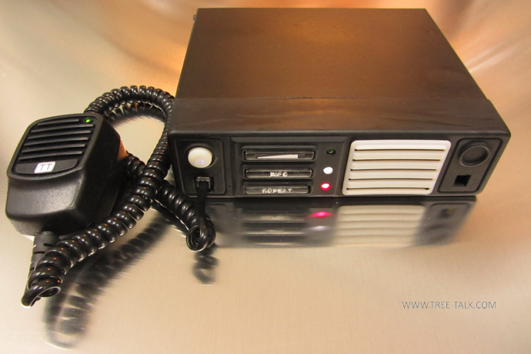
Traction and Plans
July 2014: Investment of founder.
Dec 2014: Grant for R&D has been won in the “Start” contest.
Apr 2015: First working prototype of the Terminal is ready.
May 2015: First prototype of the dispatcher's software is developed.
Feb 2016: The first R&D study, funded by FASIE, was finished. May 2016: U.S. Patent N 9,338,275 was issued.
Feb 2017: Field tests of the communicator, Web UI and server infrastructure.
2017 Q4: Web UI and server infrastructure. Pilot batch of terminals.
2018 Q2: Final version of the Terminal One ready for production.
www.Tree-Talk.com
Notes:
We have already done a lot, and we have a specific plan for the future.
We know the risks and we can achieve our goals. No doubt about that.
We strongly believe we can capture 4% of the global LMR market in 3 years or less. At the same time, we are going to branch out into some new areas.

Slide 13
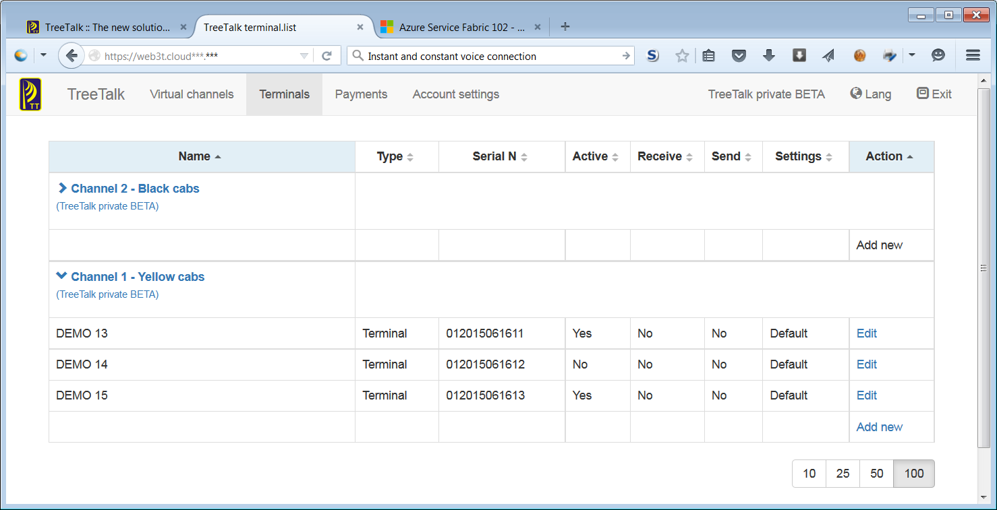
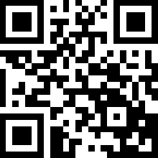
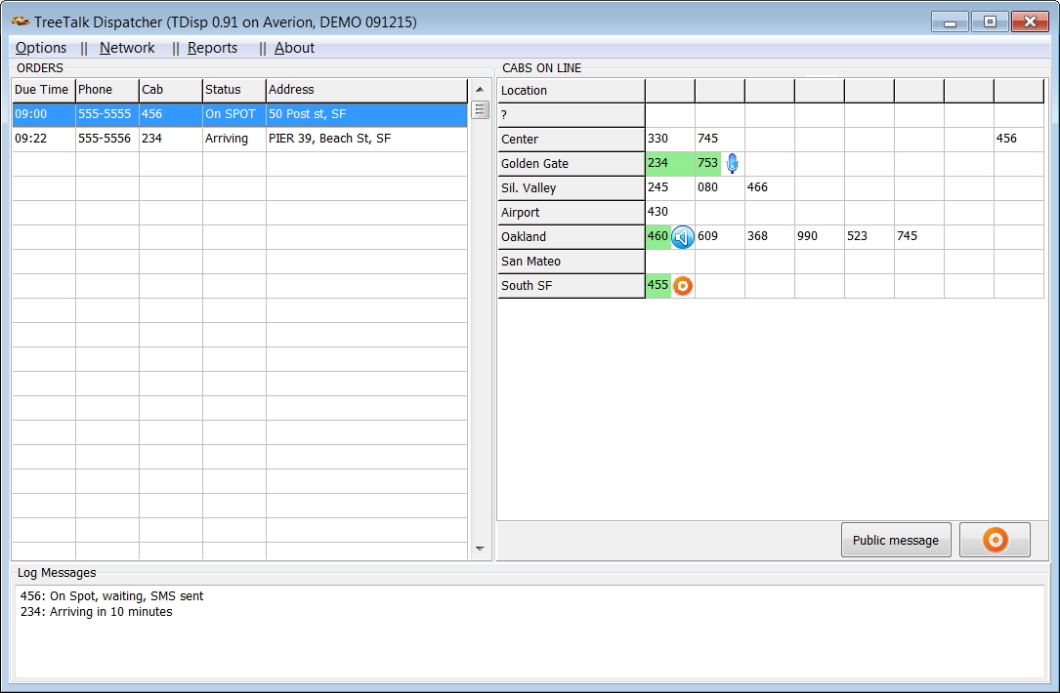
TreeTalk: Wireless Voice Terminal and System
Welcome to the future of professional communications!
http://www.Tree-Talk.com
info@Tree-Talk.com
Notes:
Thank you for your attention and welcome to the future of professional telecommunications.
Any questions?
‹#›

Slide 14
Appendixes
www.Tree-Talk.com

Slide 15
Financial Projections
Capital required to obtain the positive cash flow | $0.45M
Capital required to break-even | $1.2M
Initial addressable market | $2B / year
Total addressable market | $10B / year
Сustomer lifetime value (3-year basis) | $280
Payback period | 3 years
We are not dreaming up any new market.
There is a huge niche in the B2B segment already, developed and growing.
www.Tree-Talk.com
Notes:
We are not dreaming up any new market. There is a huge niche in the B2B segment already, developed and growing. We offer a modern and convenient solution to meet the existing needs of the customers.

Slide 16
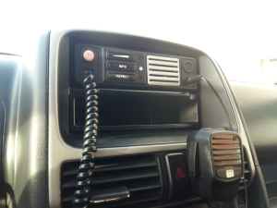
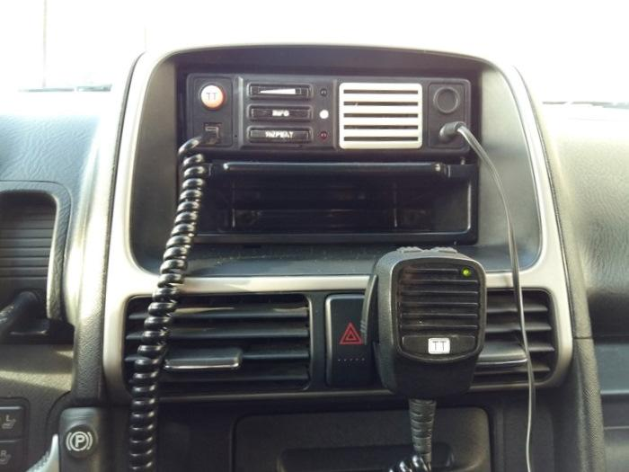
TreeTalk Road Tests
http://tree-talk.com/wp/
www.Tree-Talk.com
Notes:
Now, prototypes are being tested in the cars, which is riding around the city and near suburbs in a mode of normal use.

Slide 17
TreeTalk Leaflet / Projected Prices
www.Tree-Talk.com
Notes:
Our business model and market proposal can look more clearly from the prices in the leaflet.

Slide 18
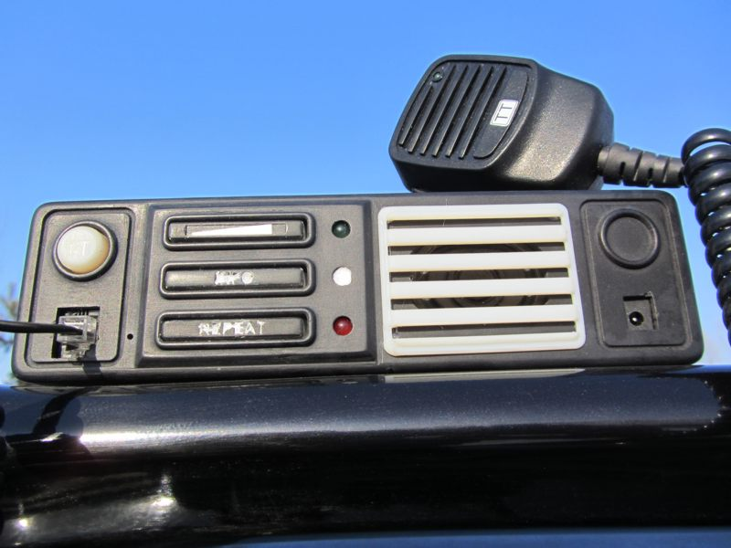
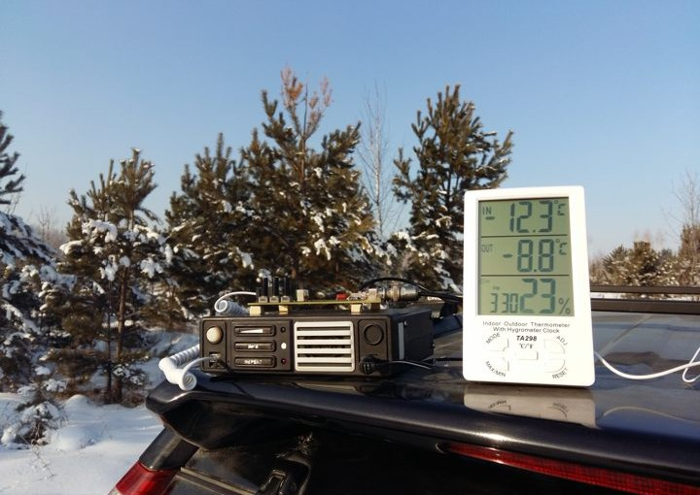
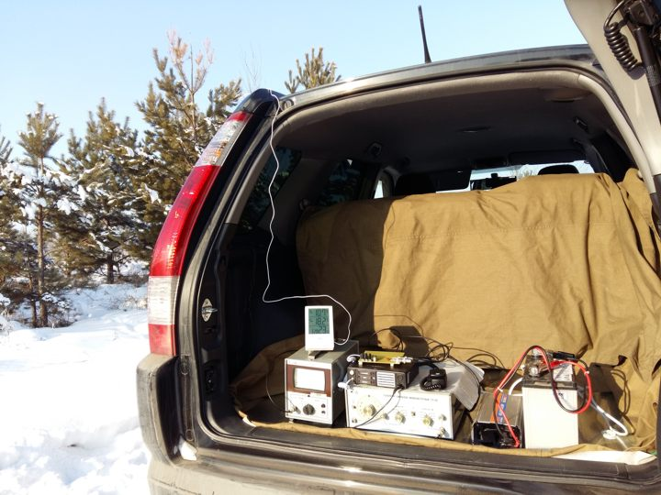
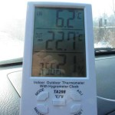
TreeTalk Winter Tests
http://tree-talk.com/wp/
www.Tree-Talk.com
Notes:
Testing has been specially planned for the winter period and held in harsh conditions. However, most of the tests completed successfully, clearly confirming the advantages of the TreeTalk terminal in the reliability and quality of the voice, and the convenience of handling over conventional and trunked radios.

Slide 19
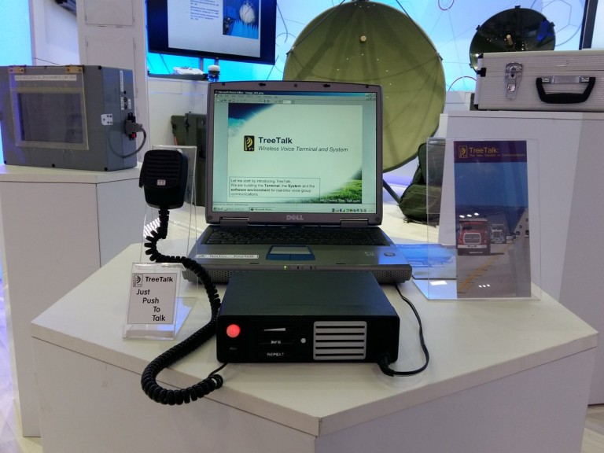
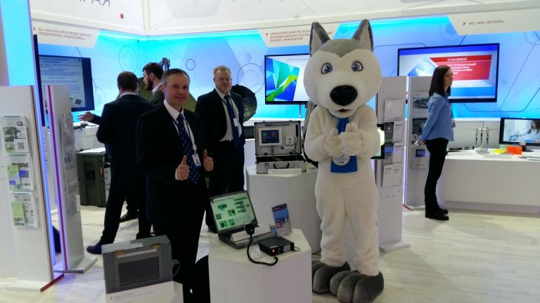
TreeTalk on #KEF2016
http://tree-talk.com/wp/
www.Tree-Talk.com
Notes:
TreeTalk took part in that huge event that gathered more than 6000 participants from different countries. Our b2b project fitted well to the format of the event. That allowed us to make a lot of contacts and to proof our ideas.

